Slide 1
Forest Fire Progression Lab
Brittany Ciancarelli
Fire Ecology Unit

Slide 2
Ground fire-when fire is burning below the surface.

Slide 3
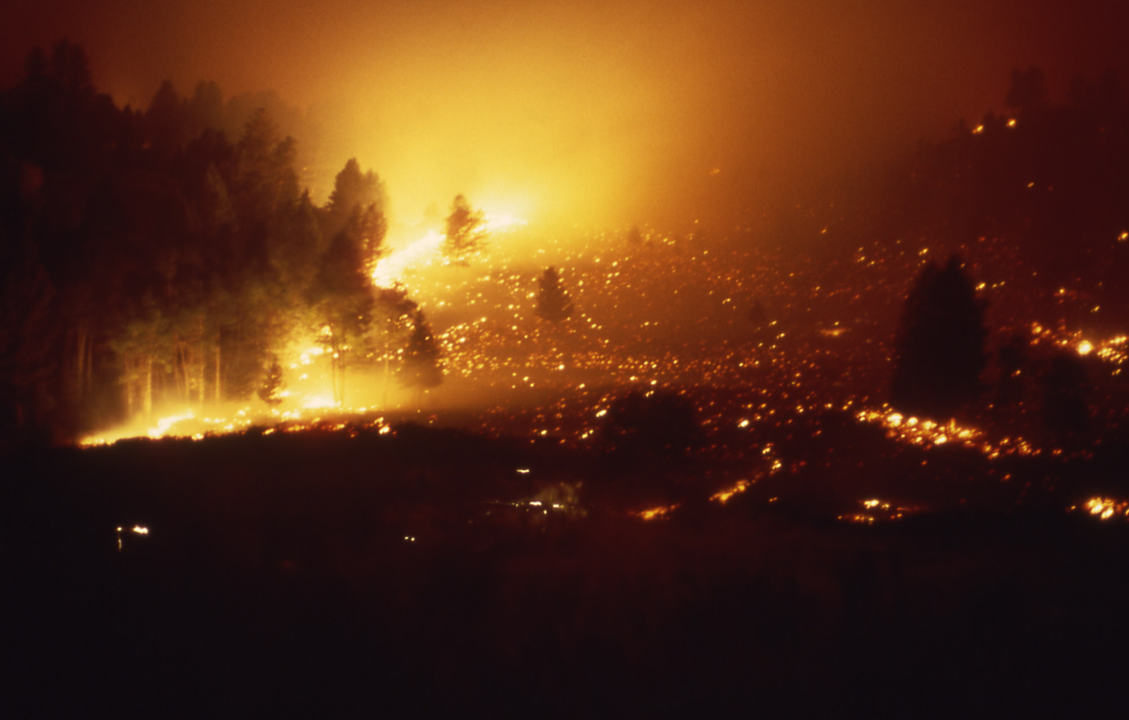
Surface fire- small fire that burns grass and baby trees on forest floor

Slide 4
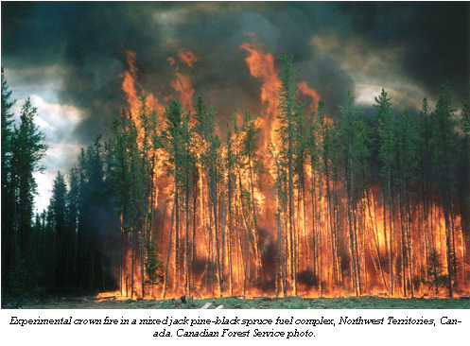
Crown Fire- Large, intense fire that burns the entire tree, including the canopy.

Slide 5
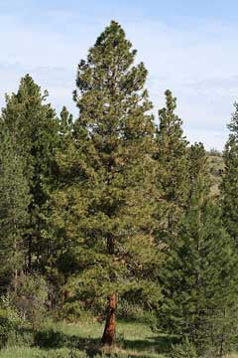
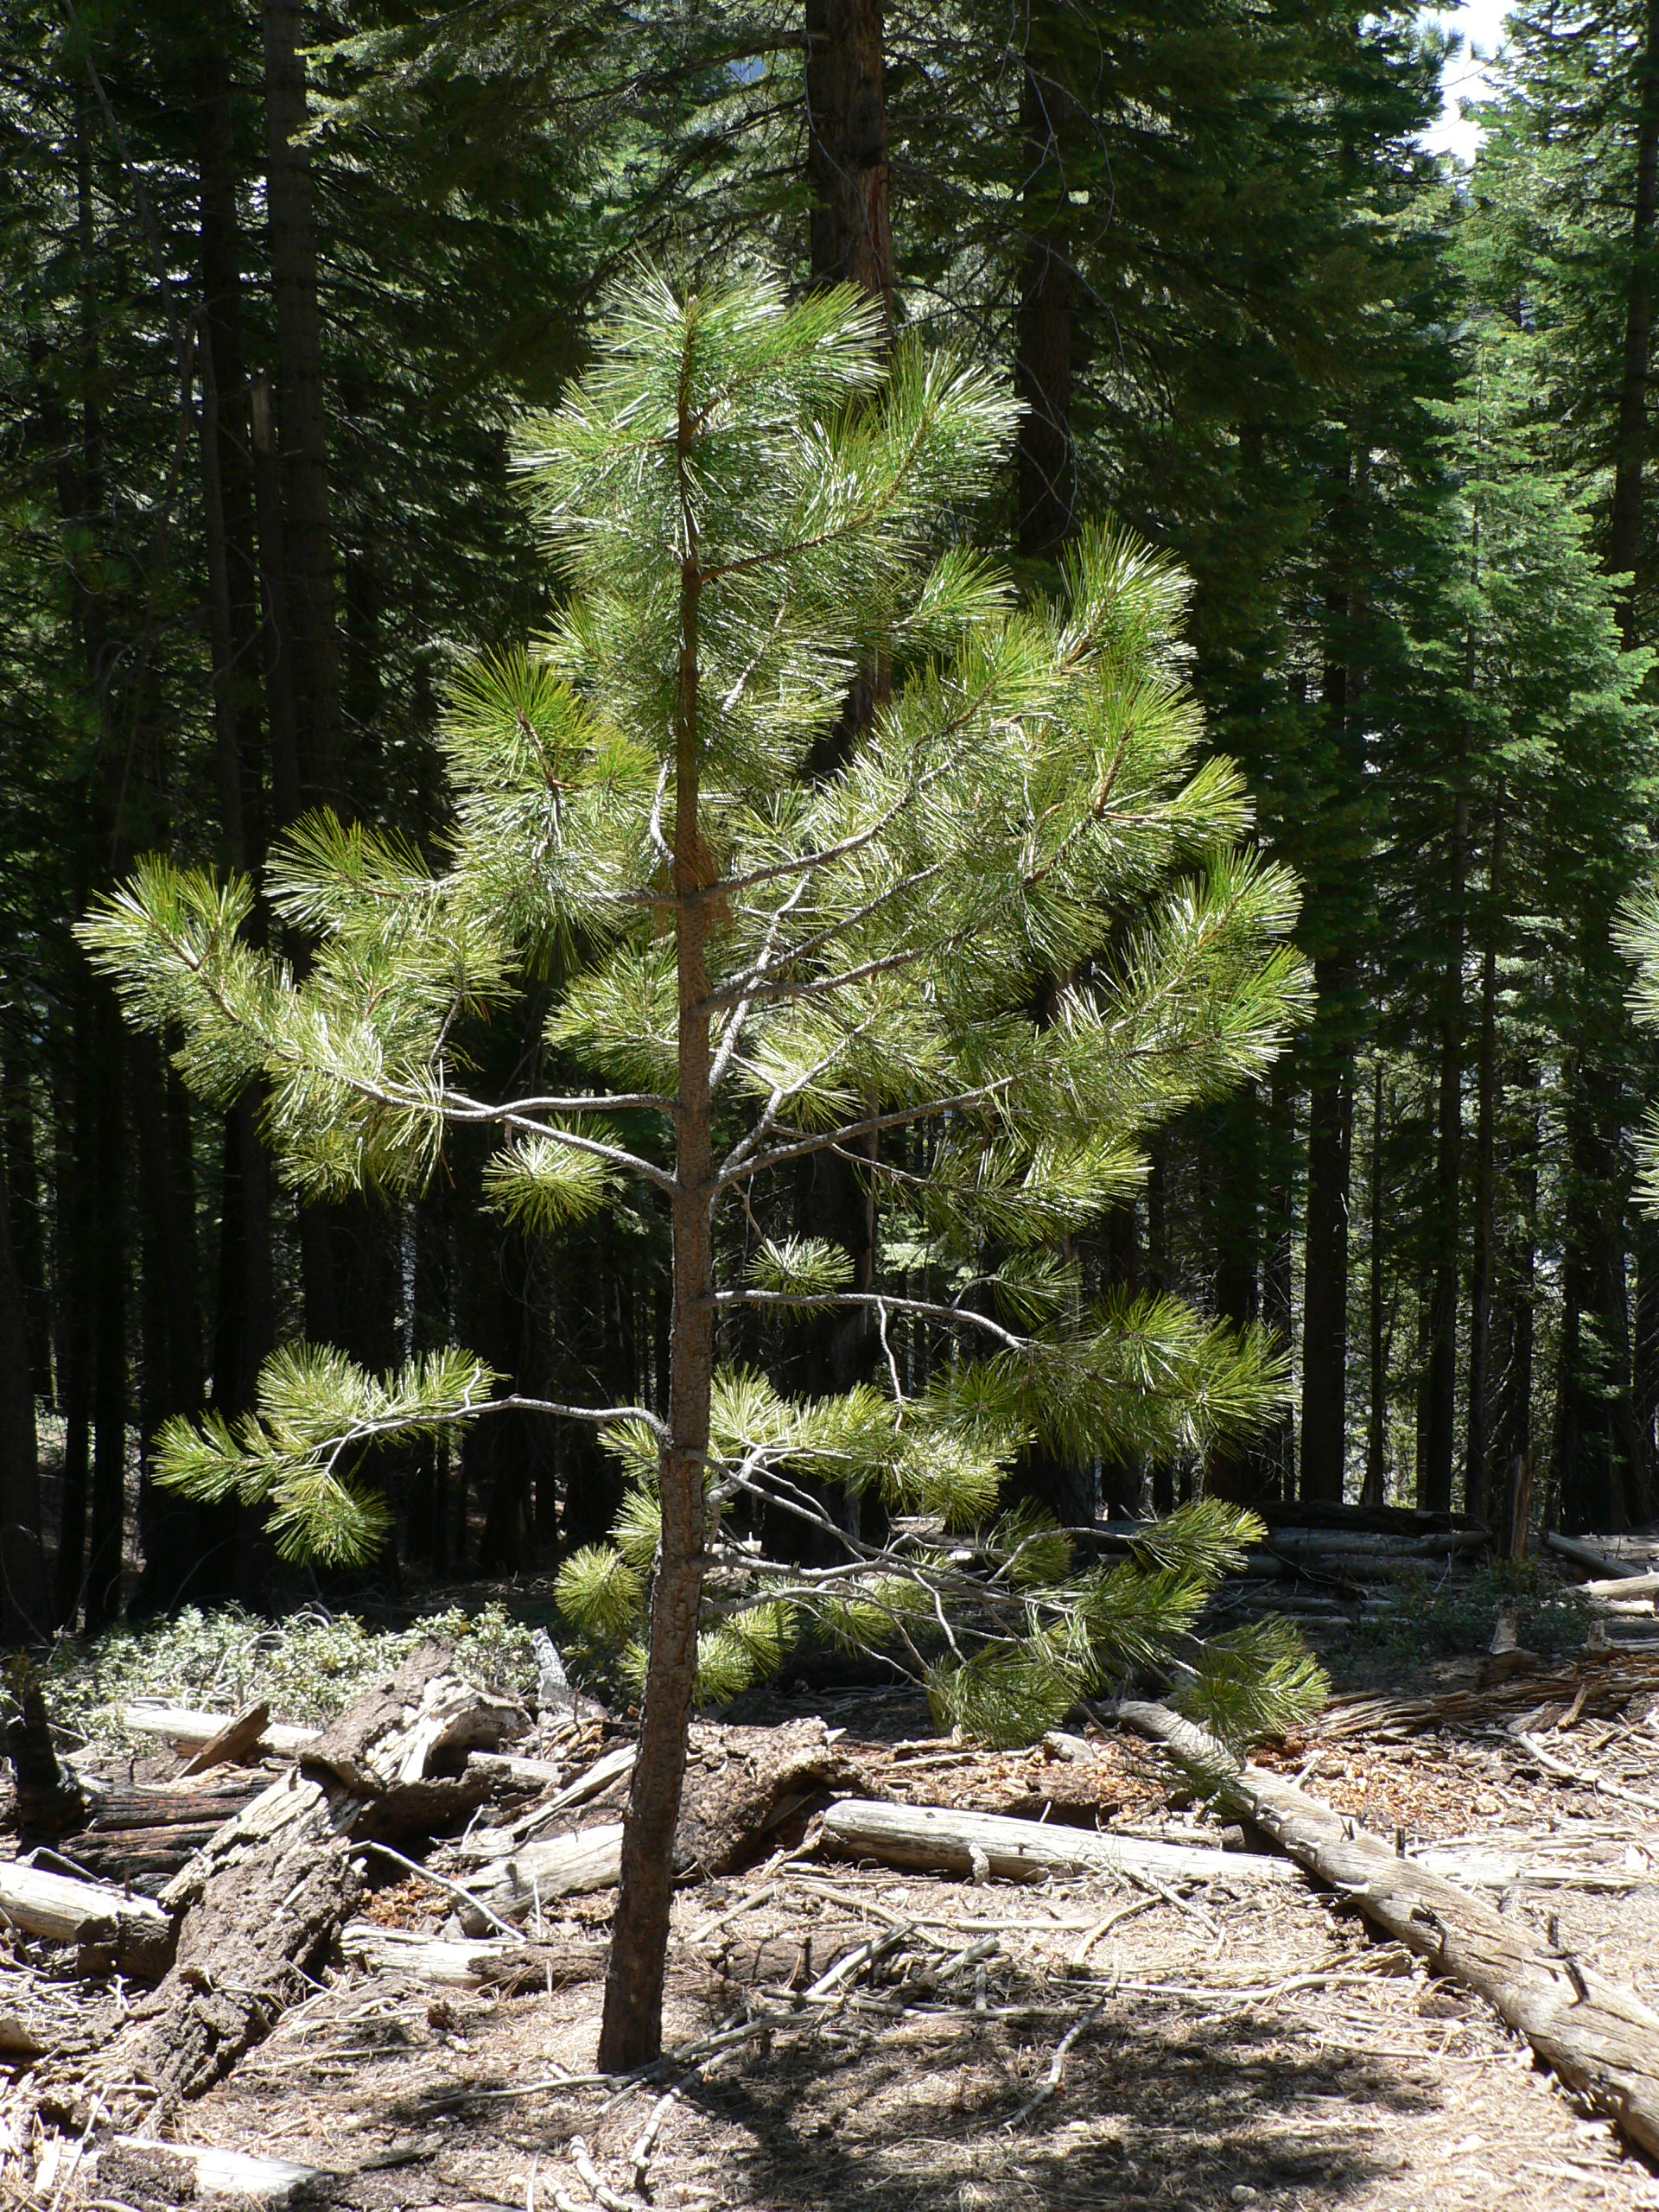
Mature, Adolescent, and Young Trees

Slide 6
1885
 | A | B | C | D | E | F
1 |  | M |  |  | M
2
3 |  |  | M
4 | M
5 |  |  |  |  | M

Slide 7
1885
Put 15 young trees in any box you like
The symbol for young trees = “y”

Slide 8
1885
 | A | B | C | D | E | F
1 |  | M | y | y | M
2 |  | y |  | y | y
3 | y | y | M | y
4 | M | y | y | y | y | y
5 | y | y |  | y | M

Slide 9
1885
If a surface fire occurs in this forest, what is going to happen to the trees?
Draw what you think the forest will look like on Forest Plot #1 After

Slide 10
 | A | B | C | D | E | F
1 |  | M |  |  | M
2
3 |  |  | M |  | y
4 | M
5 |  |  |  |  | M

Slide 11
1900
Add 15 young trees
Symbol for young trees = y

Slide 12
1915
 | A | B | C | D | E | F
1 |  | M | y | y | M
2 |  | y | y | y | y
3 | y | y | M |  | y | y
4 | M | y |  | y
5 | y |  |  | y | M | y

Slide 13
1915
Change 5 young trees to adolescents
Symbol for adolescent trees = A
Add 15 young trees

Slide 14
1915
 | A | B | C | D | E | F
1 | y | M | A | A | M y | y
2 | y | A | A | A | A y | y
3 | A | A | M | y | A | A
4 | M y | A y | y | A | y | y
5 | A | y | y | A y | M | A

Slide 15
1940
Change 5 young trees to adolescents
Add 15 young trees

Slide 16
1940
 | A | B | C | D | E | F
1 | A | M | A y | A | M A y | y y
2 | y | A y | A y | A y | A y | A
3 | A | A | M | A y | A | A
4 | M A y | A y | y y | A | y y | y y
5 | A y | y y | y y | A y | M | A

Slide 17
1970
Change 7 young to adolescents
Add 15 young trees

Slide 18
1970
 | A | B | C | D | E | F
1 | A y | M y | A y | A | M A y | y y
2 | A y | A A | A y y | A y | A y | A y
3 | A y | A y | M y | A y | A y | A y
4 | M A y | A y y | y y | A y | Y A | y y
5 | A y y | y y | y A | A A | M y | A y

Slide 19
2001
Change 3 adolescent trees to mature.
Change 8 from young to adolescent.
Add 20 young.

Slide 20
2001
 | A | B | C | D | E | F
1 | A y y | M y | A y y | A y | M A y | y y
2 | M A y | A A y | A A y | A y y | A y y | M y y
3 | A y y | A y y | M y | A y y | M y | A A y
4 | M A y | A A y | A y y | A y y | A A y | y y y
5 | A y y | A y y | y A y | A A | M y y | A A y

Slide 21
2002
A group of campers does not properly put out their camp fire, and the wind blows the embers into the forest. What kind of fire will sweep through the forest and why?
Address the following:
What will happen to the young trees?
What will happen to the adolescent trees?
What will happen to the mature trees?

Slide 22
2002
 | A | B | C | D | E | F
1 |  |  |  |  |  | M
2
3
4
5

