Slide 2
Teacher Preparation Programs
Early Childhood Education (Birth-grade 3)
Elementary Education (K-8)
Bilingual Endorsement
ESL (English as a Second Language) Endorsement
Special Education (K-12)
Mild-Moderate Disabilities
Specialize at the graduate level with accelerated masters programs!
Secondary Education (6-12)
Available Certifications:
Math
Physics
Chemistry
Biology
Earth Science or General Science
Spanish
English
History
American Government
Middle School Social Studies
Economics
Teach AZ: One year (M.Ed.)

Slide 3
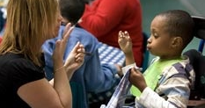
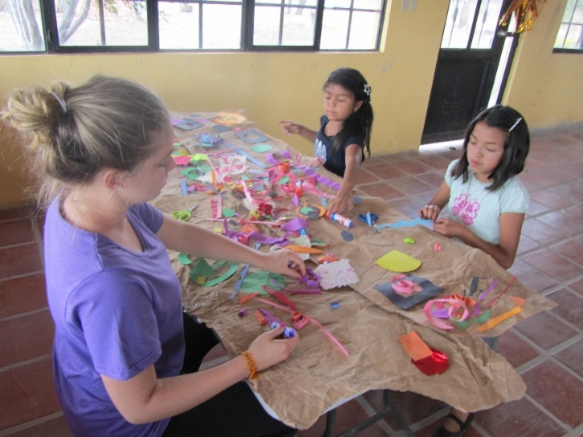
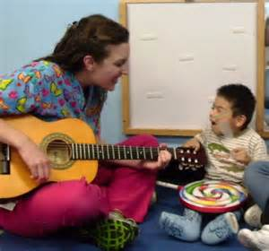
The College of Education - developing professionals to make an impact in the community
Literacy, Learning, and Leadership
Deaf Studies & Educational Interpreting
Rehabilitation Studies & Services

Slide 4
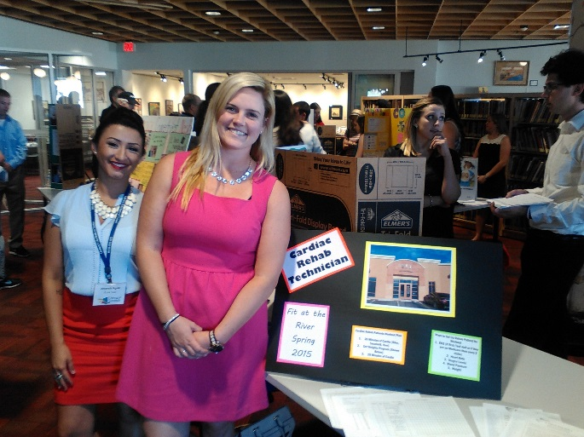
Literacy, Learning & Leadership
Non-certification program
Graduates will either work in:
Informal educational settings with children (outside of schools)
Non-profits
Recreation programs
Coaching
City or county programs
Secondary education (after Teach Arizona program)
Internship examples:
American Lung Association
Animal therapy
Art therapy
Outdoor/environmental learning
Literacy Connects
Museums

Slide 5
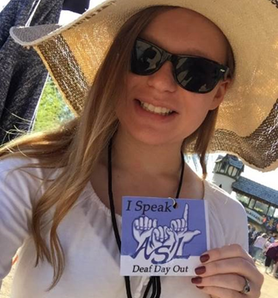
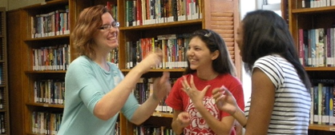
Deaf Studies
Build proficiency in American Sign Language
Learn about Deaf and Hard of Hearing culture
Only program in AZ that prepares interpreters at the bachelor’s level
Prepare for careers as:
Educational Interpreter
Job Coach with Deaf Adults
Intervener with Deaf/Blind Children
Employment Coordinator with Deaf Adults

Slide 6
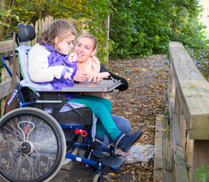
Rehabilitation Studies & Services
Not a teacher preparation program
Graduates may work as:
Mental health workers
Staff in independent living centers
Group home workers
Case Managers
Preparation for graduate programs in:
Occupational Therapy
Physical Therapy
Rehabilitation Counseling
Mental Health Counseling
Notes:
Prepares students for entry level positions as a job placement specialist, case manager, independent living center staff person, mental health worker, group home worker, supported employment specialist, and job coach to name a few.
No professional admissions process
Will take pre-health courses specific to their intended graduate program as part of the emphasis in the rehab major.

Slide 7
Graduate Programs
Educational Psychology
Educational Leadership
Principal, Superintendent
Higher Education
Language, Reading & Culture
Rehabilitation & Mental Health Counseling
School Counseling
School Psychology
Special Education
Behavioral Support
Deaf & Hard of Hearing*
Mild-Moderate Disabilities (1 year available)
Severe & Multiple Disabilities*
Visual Impairment*
(* Available as Accelerated Masters with Mild-Moderate Disabilities B.S.E.)
Teaching & Teacher Education
Includes Secondary grades 6 – 12
Notes:
TTE Additional: Envir. Learning, curriculum & instruction, MAS
LRC: Bilingual, ESL, Reading endorsements

Slide 8
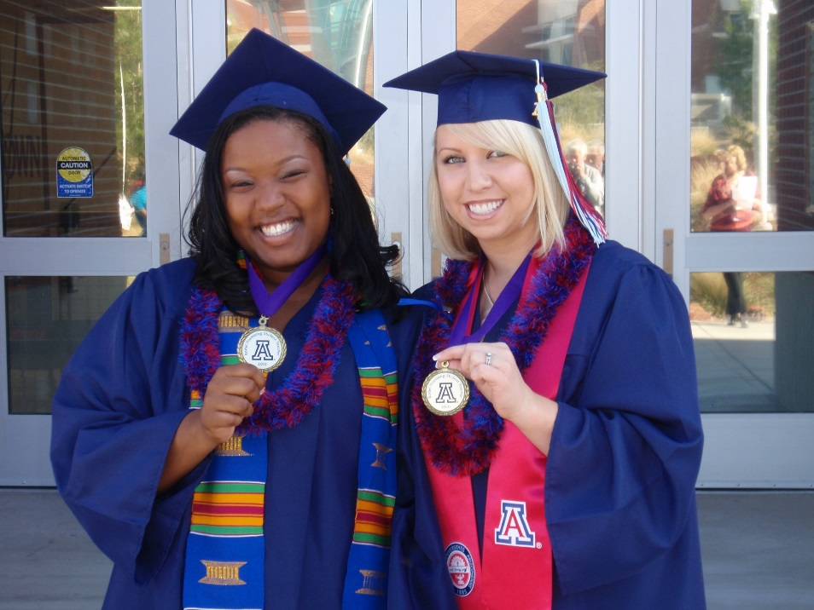
Why you should choose the UA College of Education?
Our courses are taught by more tenure-track faculty than any other university in the state of Arizona.
Our student teaching program is a nationally-recognized model for teacher preparation. Students are out in the field for 4 semesters.

Slide 9
Why you should choose the UA College of Education?
Worlds of Words is the largest collection of international children's books in the country.
2nd largest in the world!
Over 30,000 volumes
More than 5,000 square-feet
Located in the Education building 4th floor
www.wowlit.org

Slide 10
Why you should choose the UA College of Education?
COE awarded approximately $542,000 in scholarships last year to nearly 400 students
These and other scholarships are available on Scholarship Universe
https://scholarshipuniverse.arizona.edu/suha
Additional opportunities may also be available
AZ Loan Forgiveness
Secondary Education (subject-specific)
TEACH Grant

Slide 11
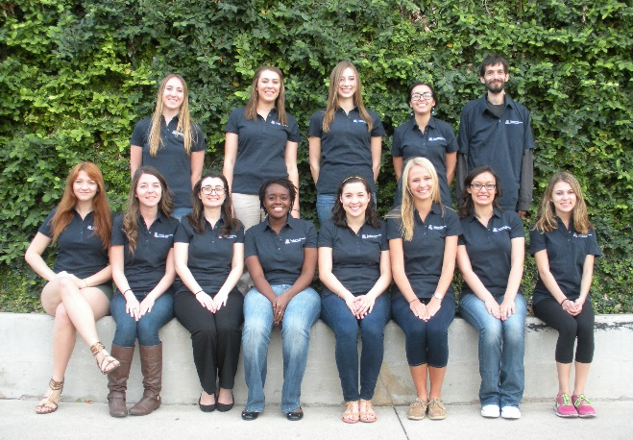
We have plenty of fun opportunities for involvement!
Placement Program
Project FOCUS
Project SOAR
Student Council
10

Slide 12
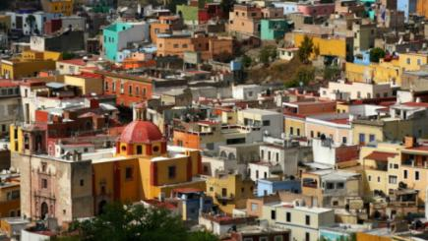
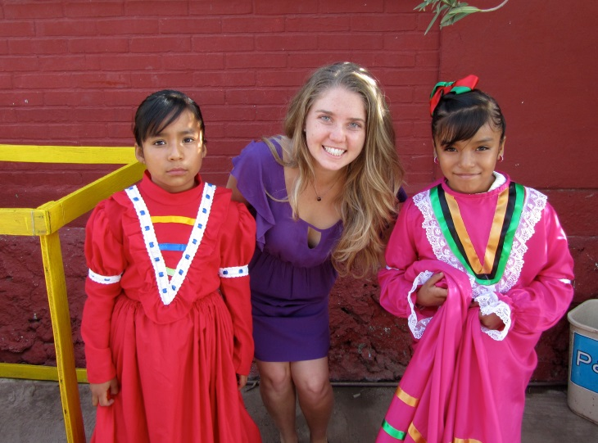
Study Abroad with Education!
Verano en Mexico
UA faculty-led program
Earn Education units
Learn about the local history and culture
Work with children in Guanajuato, Mexico
Student Teaching Abroad
China
Mexico (bilingual)
Norway

Slide 13
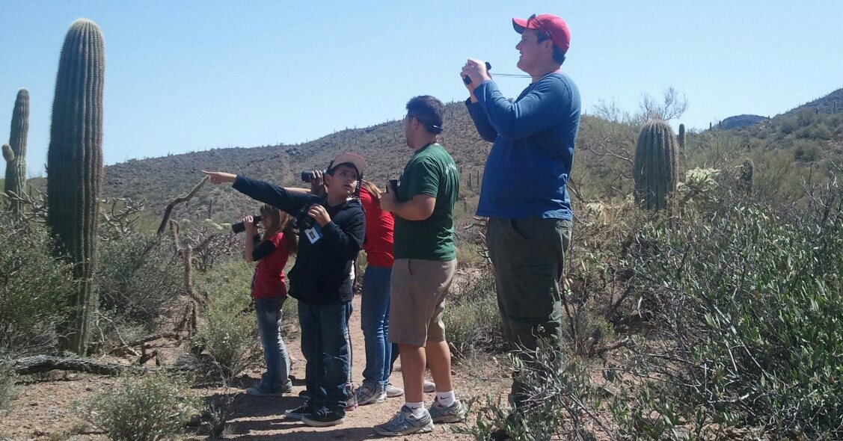
Education Minors
Adolescents, Community, and Education
Learn the benefits and challenges of working with children and adolescents in school and community settings
Educational Psychology
Gain foundations of the social, emotional and cognitive processes involved in learning
Leadership Studies and Practice
Develop a critical awareness of leadership theories and issues and build leadership skills & competencies
Recreation & Sport in Communities, Parks, and Schools
Enhance quality of life and healthy development through inclusive recreation and sport activities
Special Education & Rehabilitation
Build general knowledge in working with people of different abilities and backgrounds

Slide 14
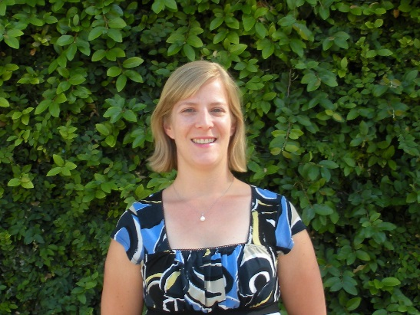
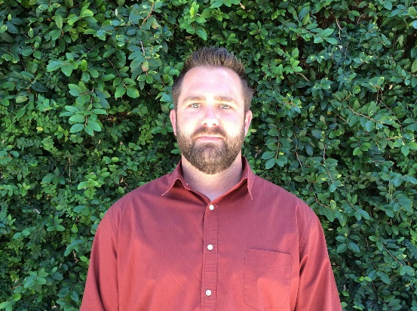
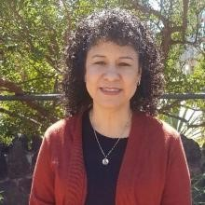
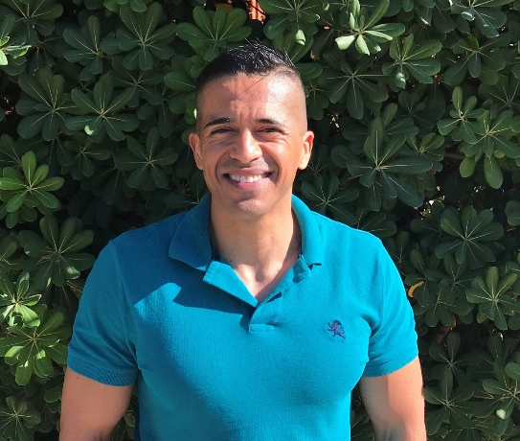
Meet Your Advisors!
Sara Knepper
Shaun Cahill
We are here for you!
Alonso Minjarez
Letty Molina-Gutierrez

Slide 15
Next Steps!
To revisit this information, visit our General Info Session at www.coe.arizona.edu/gis
Schedule a meeting with an advisor
Call 520-621-7865
Education 247 Student Services front desk
Calendly links for each advisor
We look forward to seeing you soon!

