Slide 1
The Mangle of Race and the Importance of Racially-Inclusive Pedagogy
Jill Koyama, PhD &
Francesca A. López, PhD
New Instructor Orientation
College of Education
August 15, 2016
Notes:
I like the terms “mangle” or “entanglement” rather than intersectionality when talking about race, etc… Is that okay with you? I will explain a bit as we do our first exercise—which is essential asking each person to write down his or her race on a card. Then writing the race of the person next to them on another card, and finally writing my race down on a card. They hand in “my cards” to me. And then give the card to the person they “raced” and then we share—opens up discussion for assumptions, phenotype, stereotypes, etc…I have used it class with some success. For me, I doubt anyone will call me yellow, so then we can talk about how racial categories uneven—Black, white, Latinx, Asian…

Slide 2
The World We Live In
https://www.youtube.com/watch?v=uSM74Pqi288
Notes:
Talk a bit about “intersectionality”—within ourselves, and across society—problematize race

Slide 3
The Mangle

Slide 4
What is race?

Slide 5
Some (awful) definitions
a competition between runners, horses, vehicles, boats, etc.
a family, tribe, people, or nation belonging to the same stock
an actually or potentially interbreeding group within a species
category of humankind that shares certain distinctive physical traits

Slide 6
Better definitions
Race is not biological. It is a social construct. There is no gene or cluster of genes common to all blacks or all whites.
Race is a divisive tool utilized repeatedly and systematically to maintain societal stratification and justify inequity
Race formation is the sociohistorical process by which racial categories are created, inhabited, transformed, and destroyed. Race is a matter of both social structure and cultural representation

Slide 7
Notes:
Data come from GenForward, a survey of the Black Youth Project at the University of Chicago with the AP-NORC Center, with a nationally representative sample of 1,940 adults 18-30 years old. Interviews were completed online and using landlines and cellphones from July 9-20, 2016. Results have a margin of sampling error of +/- 3.8 percentage points. A full report by the Black Youth Project is available at www.GenForwardSurvey.com. The proper description of the survey’s authorship is as follows: GenForward is a survey of the Black Youth Project at the University of Chicago with The Associated Press-NORC Center for Public Affairs Research.

Slide 8
Forms of racism

Slide 9
https://www.youtube.com/watch?v=DWynJkN5HbQ

Slide 10
Racism reconsidered
Notes:
I don’t actually like the term “White Supremacy”; prefer racist, but…

Slide 11
“Post-Racialism”
“Saying I’m obsessed with race and racism in America is like saying that I’m obsessed with swimming while I’m drowning. It’s absurd.”
-Hari Kondabolu

Slide 12
POTUS

Slide 13
Ways of Whiteness
1960s: Whiteness destabilized
Still systemically privileged
Institutional racism
Rearticulated from dominant to normal

Slide 14
Microaggressions
What are they?
“brief, everyday exchanges that send denigrating messages to people of color because they belong to a …. minority group” (Sue et al., 2007, p. 273)
Although subtle in delivery, researchers have found microaggressions to be cumulative in nature and “more problematic, damaging, and injurious to persons of color than overt racist acts” (Sue, 2003, p. 48)
Notes:
…because they are often “invisible” to most, it easily builds.
So first I wanted to share some photographs. These students were asked to provide one of the microaggressions they often hear.
These can include renaming our students or mispronouncing their names, and even the issues we saw in the clip just now.

Slide 22
What are microaggressions?
https://www.youtube.com/watch?v=_85JVcniE_M
https://www.youtube.com/watch?v=KPRA4g-3yEk
Notes:
When we see it FLIPPED, the absurdity helps make it more obvious why microaggressions are what they are. They exemplify that we are constantly using a norm that places some people as “others” against the “norm.” So an AA female told someone DOES NOT see color sees it as a MA; a young lady is told she is “white” is also a MA.

Slide 23
Microaggressions
“You speak good English.”
“You are a credit to your race.”
“You are so articulate.”
Asking an Asian person to help with a math problem.
When I look at you, I don’t see color.

Slide 24
Other ways we transmit microaggressions
https://www.youtube.com/watch?v=Dd7FixvoKBw

Slide 25
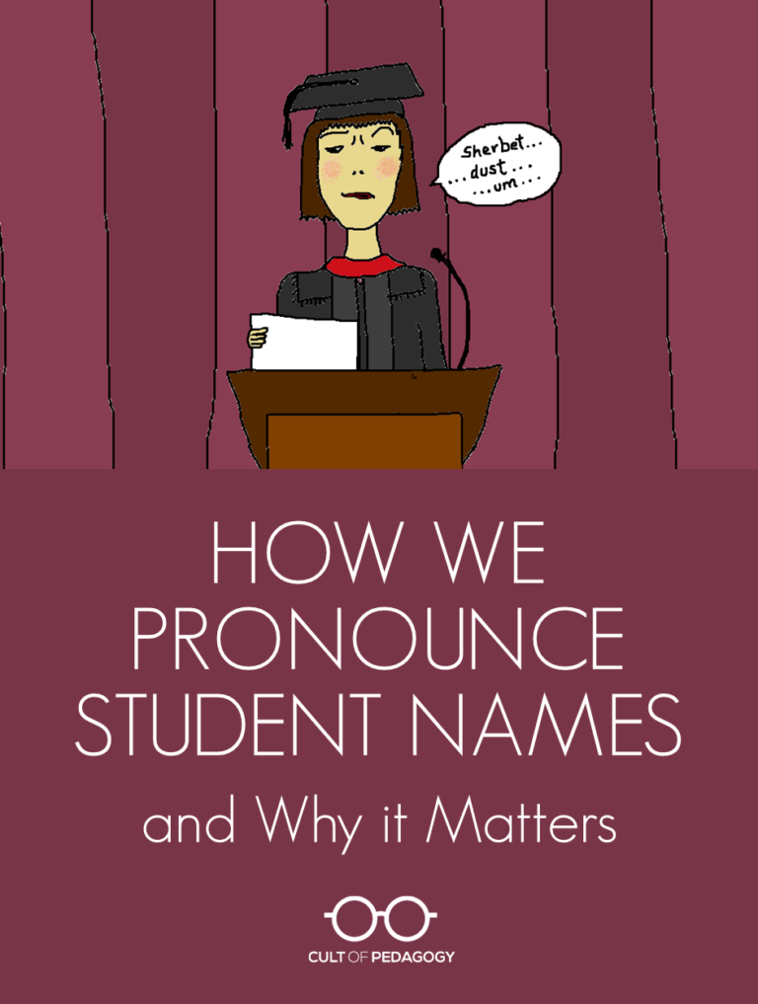
Aim to be a “calibrator”
http://www.cultofpedagogy.com/gift-of-pronunciation/

Slide 26
Questions and/or Comments?

Slide 27
Part II: Additional Key Concepts
Stereotype Threat
White Privilege
Deficit Models/pobrecito

Slide 28
Stereotype Threat
Things “in the air” that affect us

Slide 29
What are stereotypes?
Pros: Brain’s efficiency at interpreting information
Cons: They are generalizations that are inaccurate

Slide 30
What is “Stereotype Threat”?
a threat tied to an identity
present in any situation to which the stereotype is relevant
Everyone experiences this in some form
It is dependent on the scenario and stereotypes

Slide 31
Stereotype Threat : No Explicit Bigotry Required

Slide 33
Early Experiment on Stereotype Threat
SATs were underpredicting GPA for African American students at University of Michigan
Why was there reduced performance?
Steele & Aronson (1995). Journal of Personality and Social Psychology.

Slide 34
Verbal Test Performance
“Primed”

Slide 35
Additional Studies Finding Performance Effects
Latinos taking English verbal tests
Seniors taking short-term memory tests
Students from low socioeconomic backgrounds taking verbal tests
Women taking tests of driving
Women taking math tests
White males taking math tests (primed comparison with Asians)
White males taking tests of social sensitivity
….

Slide 36
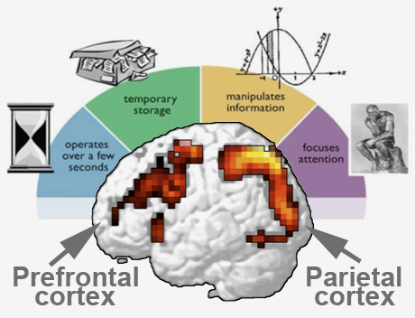
WHY?!?
It reduces the space in our working memory—the “place” where we process information

Slide 37
General Conclusions from 300 Studies
One need not believe the stereotype is true to feel the pressure to disprove it
ST can affect even those students with an established record of performance who have confidence in their abilities
Stereotype threat influences long-term as well as immediate performance
Stereotype threat can arise as a function of grouping alone: integrated groups trigger it

Slide 38
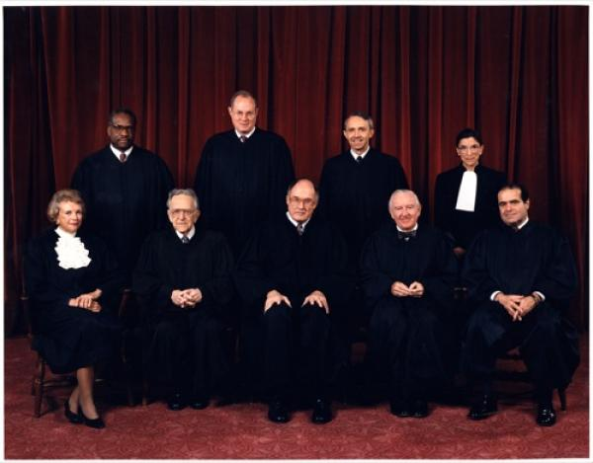
Critical mass: enough people with similar identities to mitigate ST
"O’Connor said her early years on the court were asphyxiating…. There was hyper-scrutiny from all camps to see how she would vote” (Steele, 2011)
When asked to identify her happiest day on the Supreme Court, Justice O’Connor reports that it is the day Justice Ruth Bader Ginsberg joined.
“People ask me sometimes, when — when do you think it will it be enough? When will there be enough women on the court? And my answer is when there are nine.” Ruth Bader Ginsberg, 2015

Slide 39
Reducing Threat

Slide 40
Strategies to Reducing Effects of Stereotype Threat
Stress the malleability of intelligence
Exposure to Role Models
Teaching about ST

Slide 41
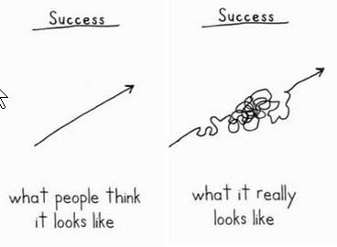
Strategies to Reducing Effects of Stereotype Threat
Awareness of the external difficulties: Normalizing struggle
Formative feedback

Slide 42
Deficit Models/pobrecito
Framework
POC incapable
White savior
VERY popular in film, philanthropy, and education
Do POC really need saving?

Slide 43
“ If you have come here to help me, you are wasting your time. But if you have come because your liberation is bound up with mine, then let us work together.” -Lilla Watson

Slide 44
Black Lives Matter is joining the fight against deportations
http://fusion.net/story/333395/black-lives-matter-fighting-deportations/

Slide 45
Start With Correct Framing
“It is not a Black problem. It is a white problem. This is an American problem.”
-Jesse Williams on the Michael Dunn case in the Atlanta Blackstar (2/15/14)

Slide 46
Appropriating

Slide 47
Language matters
Preempt
“Not to be racist…”
“I’m not a racist, but…”
Does this remind you of anyone in a political race right now?

Slide 48
“Polite”/ “Common” racist language and messages
Gypsy and gyp
No can do
Shuck and jive
Peanut gallery
Uppity
…….

Slide 49
Some Concluding Thoughts
Point is to continually engage
Race is central to education and pedagogy
Color-blindness doesn’t work
Resources exist—see the Race Project (Anthropology)
Tension: Race isn’t real, but race is real

Slide 50
Thank You! Questions/Comments?
Contact: Dr. Francesca A. López
falopez@email.arizona.edu
Dr. Jill Koyama
Jkoyama@email.arizona.edu
@Koyamawonders

