Slide 1
General Information
Presentation

Slide 2
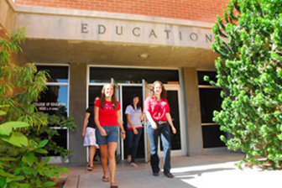
Application Process
To apply to the University of Arizona, click here
To apply to College of Education, click here
Application needed for Elementary Education, Early Childhood Education, Mild-Moderate Disabilities, or Deaf Studies
Complete all general education requirements and specific courses for desired major
Meet with an academic advisor to go over details
Must have completed over 60 volunteer hours
Must have two references

Slide 3
Teacher Preparatory Majors
Early Childhood Education
Teach ages birth-3rd grade
Elementary Education
Teach in grades 1-8
Endorsements
Bilingual
English as a Second Language
Mild-Moderate Disabilities
Teach in grades K-12
These programs are for ARIZONA CERTIFICATION ONLY
Refer to previous slide for requirements for application

Slide 4
Non-Teacher Preparatory Majors
Literacy, Learning, and Leadership
Community outreach and internship opportunities which introduce potential career paths
Promoting learning and literacy outside of a classroom setting
Deaf Studies
Choose an emphasis: Educational Interpreting, Teacher Preparation, Counseling, OR create your own
Opportunities to work in and alongside interpreters, K-12 educational settings, and community organizations that aid the deaf and blind
Rehabilitation
Supervised coursework involving addictions, aging, mental health, and sexuality
Participate in and volunteer with organizations that actively advocate for inclusion and access

Slide 5
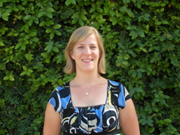
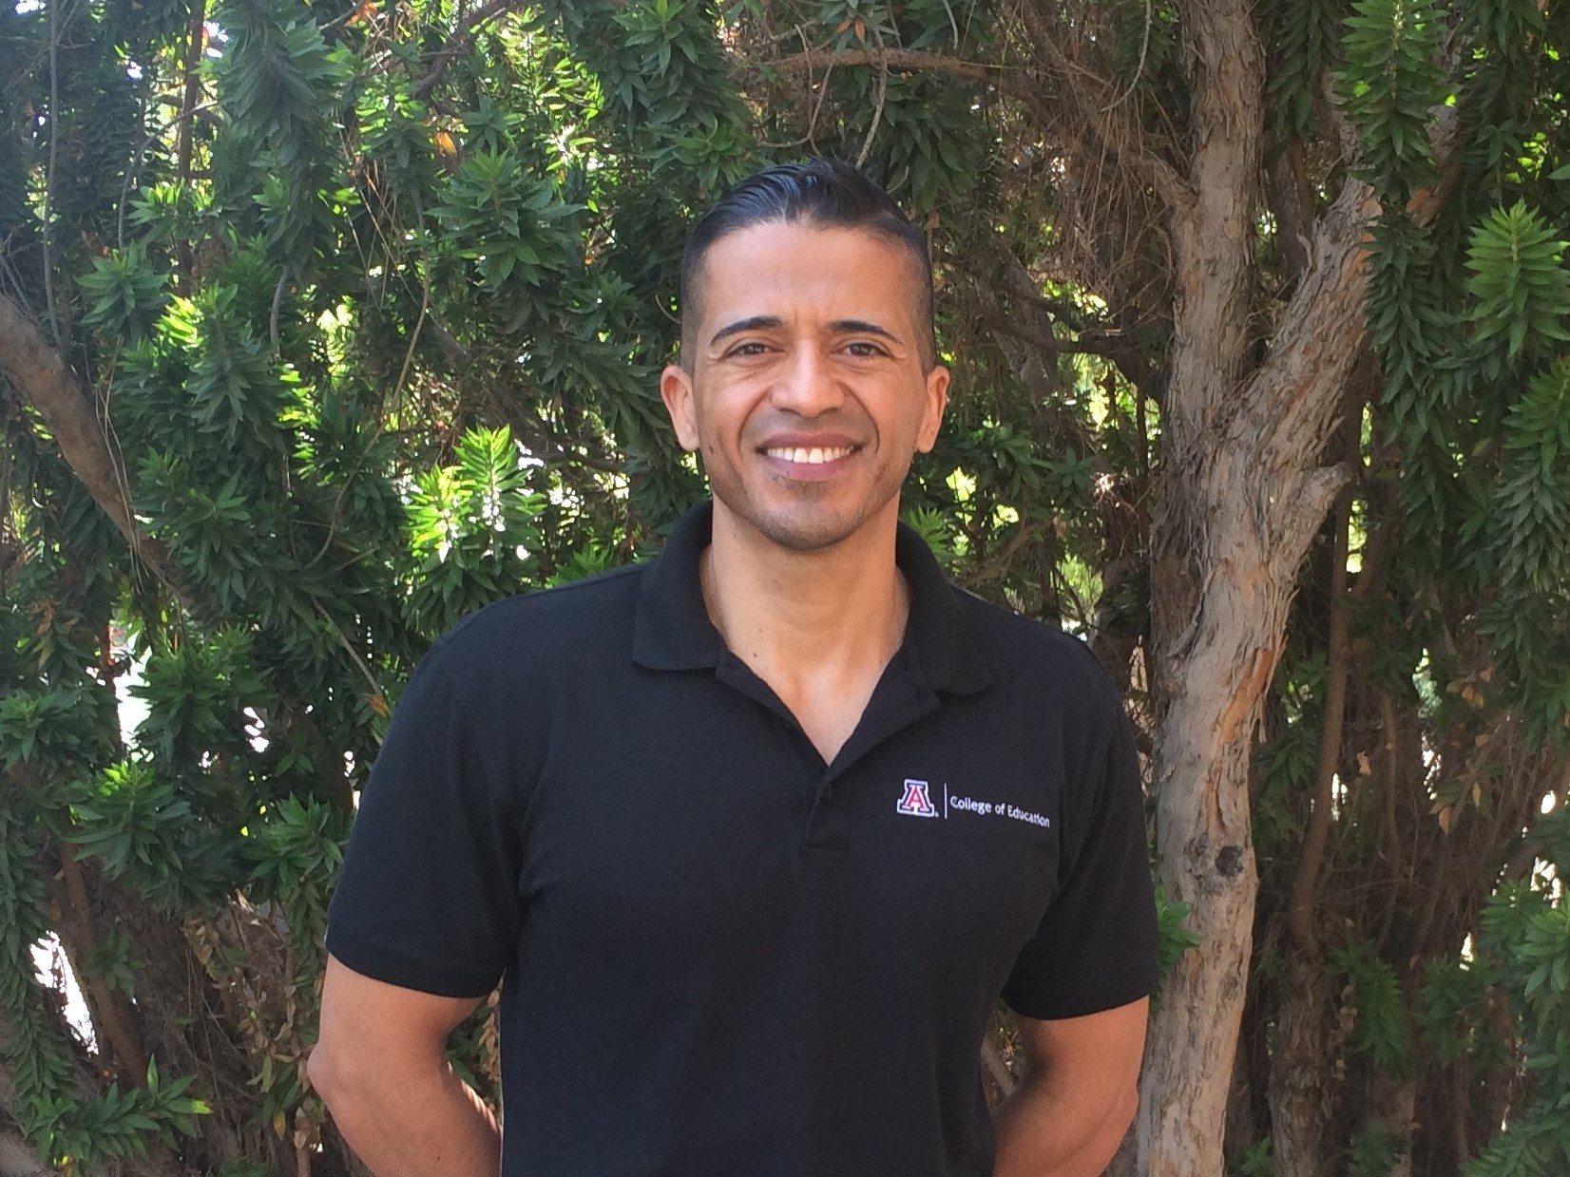
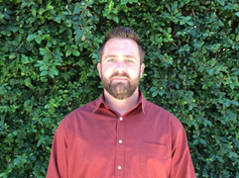
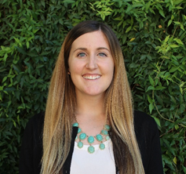
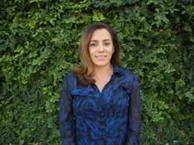
Meet the
Advisors!
Sara Knepper
Director
R
calendly.com/saraknepper
Alonso Minjarez
A-C, X-Z & Minors
calendly.com/alonsom
Shaun Cahill
J-Q
calendly.com/cahill
Advising is sorted depending on the student's last name. To schedule an appointment with your advisor, use the calendly scheduling system by following the link below your advisor.
Angela Botello
D-I
calendly.com/abotello
Allison Scherer
S-W
calendly.com/allisonsv

Slide 6
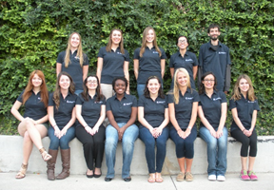
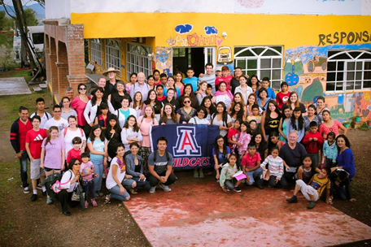
Getting Involved
There are several ways to get involved with the College of education. Some opportunities for students include:
Verano en México
Future Teacher’s Club
C.O.E. Leaders
COE Ambassadors
Deaf-Hearing Student Alliance
Study Abroad
To learn more, Click Here!

Slide 7
Ways to Succeed in College of Education
Meet with your advisor at least two times per semester
Get to know your professors by going to office hours
Ask questions while establishing a more personal relationship
Make friends with College of Education students who are further along in the educational process than you
Learn what they did correctly or what they wish they would’ve done earlier in their academic career
Check your UA email regularly
Check your D2L regularly
Use campus and College of Education resources to your advantage

Slide 8
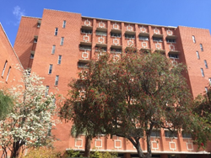
Contact Information
COE Website
Student Services Office phone number: 520-621-7865
Dean’s Office phone number: 520-621-1462
Address for College of Education: 1430 E. 2nd Street Tucson, AZ 85721 P.O. Box 210069
Student Services Office Room 247

