Slide 1
General Information
Presentation

Slide 2
Application Process
To apply to the University of Arizona, click here
To apply to College of Education, click here
Application needed for Elementary Education, Early Childhood Education, Mild-Moderate Disabilities, or Deaf Studies
Complete all general education requirements and specific courses for desired major
Meet with an academic advisor to discuss details and create a personalized plan of study
Must have completed 60 hours of experience with population of interest (teacher prep only)
Must have two references
Must have AZ IVP fingerprint clearance card

Slide 3
Teacher Preparatory Majors
Early Childhood Education
Teach birth-3rd grade
Elementary Education
Teach in grades K-8
Endorsements
Bilingual
English as a Second Language
Mild-Moderate Disabilities
Teach special needs in grades K-12
These programs are for ARIZONA CERTIFICATION
Refer to previous slide for requirements for application

Slide 4
Additional Majors
Deaf Studies
Choose an emphasis: Educational Interpreting, Teacher Preparation, Counseling, OR create your own
Opportunities to work in and alongside interpreters, K-12 educational settings, and community organizations that aid the deaf and blind
Literacy, Learning, and Leadership
Community outreach and internship opportunities which introduce potential career paths
Promoting learning and literacy outside of a classroom setting
Rehabilitation
Supervised coursework involving addictions, aging, mental health, and sexuality
Participate in and volunteer with organizations that actively advocate for inclusion and access

Slide 5
Minors
Adolescents, Community and Education (ACE)
Designed to introduce all majors from across the University to the benefits and challenges of working with children and adolescents in school and community settings.
Educational Psychology
Provides a foundation of knowledge and skills of the social, emotional and cognitive processes involved in learning. Educational Psychologists apply their findings to improve the learning process.
Leadership Studies and Practice
Offers students an opportunity to develop a critical awareness of leadership theories and issues as well as develop essential leadership competencies and skills needed in any career field.
Special Education & Rehabilitation
Designed to introduce general knowledge in working with people of different abilities and backgrounds.
For more information click here.

Slide 6
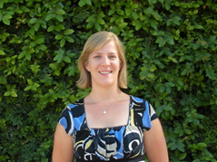
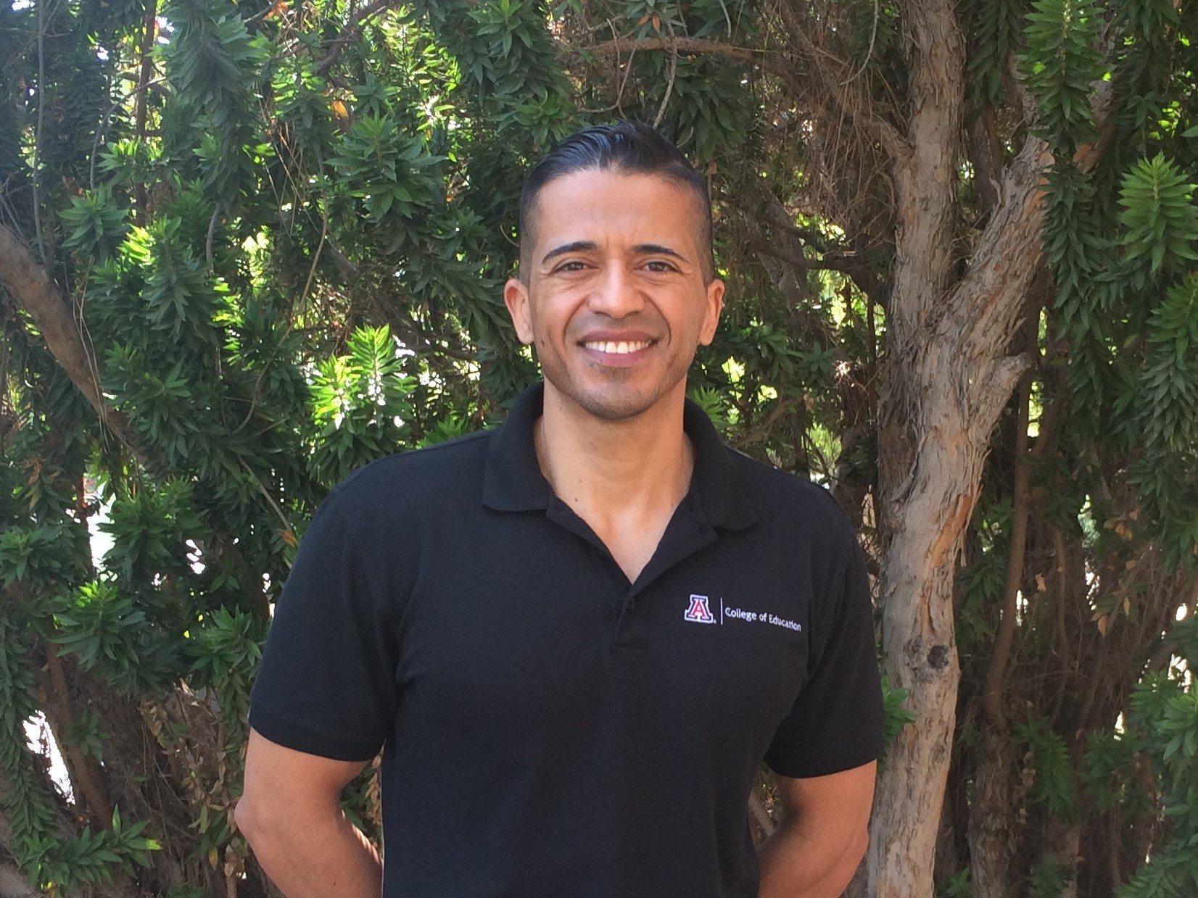
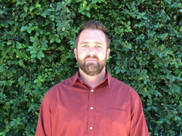
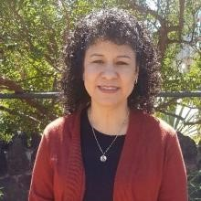
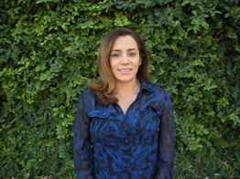
Meet the
Advisors!
Alonso Minjarez
All COE minors Deaf Studies & Pre-Deaf Studies Rehabilitation
Sara Knepper
Exploratory Pre-Education ITEP, & special cases
Shaun Cahill
Elementary & Pre-Elementary Alpha L-Z, Early Childhood & Pre-Early Childhood
Advising is sorted depending on the student's program of study. To schedule an appointment with your advisor, use the calendly scheduling system by following the link within your advisor’s name.
Angela Botello
Elementary & Pre-Elementary Alpha A-K, Mild-Moderate Disabilities
& Pre-Mild-Moderate Disabilities UA Online students
Letty Molina-Gutierrez
Literacy, Learning, and Leadership majors

Slide 7
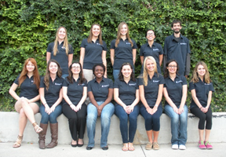
Getting Involved
There are several ways to get involved with the College of education. Some opportunities for students include:
Verano en México
Future Teacher’s Club
C.O.E. Leaders
COE Ambassadors
Deaf-Hearing Student Alliance
Study Abroad
To learn more, Click Here!

Slide 8
Ways to Succeed in College of Education
Meet with your advisor at least two times per semester
Get to know your professors by going to office hours
Ask questions while establishing a more personal relationship
Make friends with College of Education students who are further along in their education and program
Learn what they did correctly or what they wish they would’ve done earlier in their academic career
Check your UA email regularly
Check your D2L regularly
Use campus and College of Education resources to your advantage

Slide 9
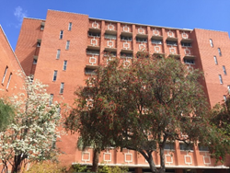
Contact Information
COE Website
Student Services Office phone number: 520-621-7865
Dean’s Office phone number: 520-621-1462
Address for College of Education: 1430 E. 2nd Street Tucson, AZ 85721 P.O. Box 210069
Student Services Office Room 247

