Slide 1
College of Education Instructor Training
“Although the University of Arizona may not be as progressive as neighboring campuses in California, it does represent the most LGBT-friendly campus in the state and one of the best choices in the Southwest.”
- The Advocate: College Guide for LGBT Students
Notes:
What we are going to do today—Look at LGBTQ Issues in Schools
Frame the conversation with a video
Share with you what LGBTQ affairs does
Talk about issues LGBTQ students face in schools
Explore what you can do through role playing/scenarios
Share how you can help their office

Slide 2
Pronoun Round
He/Him/His Pronouns
She/Her/Hers Pronouns
They/Them/Their Pronouns
Notes:
To start off our conversation, we’re going to begin with a “pronoun round.” This is an opening activity we often see within environments that are openly supporting of LGBTQ+ individuals and identities. Does anyone know what a pronoun round is? In this activity, we’re in essence going to go around the room, introduce ourselves with our name and our pronouns.
-Why we don’t say “preferred” pronouns.

Slide 4
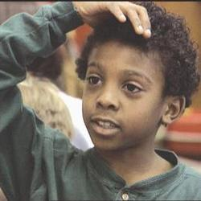
It’s Elementary—Talking about Gay Issues in Schools
All kids are affected by LGBTQ prejudice, and all adults have the ability and responsibility to address it.
http://www.youtube.com/watch?v=PWyj_OfQpnU
Notes:
The film “It’s Elementary” addresses the topic of working with students from K-12 to college on how to appropriately deal with LGBTQA issues in schools
Though we don’t have time to watch the whole video, I wanted to share this brief excerpt since it is the only film to address this topic head on—and it gives us an opportunity to hear from children
This is really WHY we need to have these conversations
SHOW CLIP
Like one of the teacher’s in the video says: teachers have to be there for all their students, and I know it’s your job to support them in that.

Slide 5
Welcoming Schools
http://www.welcomingschools.org/our-films/what-can-we-do/
http://www.welcomingschools.org/our-films/what-do-you-know/
Notes:
Here’s at two other short videos from the Welcoming Schools resources.

Slide 6
The mission for the Office of Lesbian, Gay, Bisexual, Transgender, Questioning (LGBTQ) Affairs is to build, sustain and strengthen a safe, inclusive, and open environment for faculty, staff, appointed professionals, students, alumni, parents, and guests of all gender identities and sexual orientations.
Notes:
The decision to create the Office of LGBTQ Affairs was brought about after nearly twenty years of advocacy by LGBT students, faculty and staff—People who devoted hour-upon-hour to promote equity in University policies and practices and build an inclusive campus climate. (I am aware that I stand on their shoulders in the work I do on campus).
In recognition of the significant needs of this marginalized community, the President’s LGBT Advisory Council recommended that President Shelton hire a Director of LGBTQ Affairs, which he did in 2007. The council did this for 2 primary reasons:
1. For students, the council recognized the significant needs of this marginalized community--Sadly we know that LGBTQ students as a group are at a higher risk of isolation, depression, substance abuse, and even suicide
2. For faculty and staff, the council recognized that to achieve our goal of becoming a top ten public research institution, we need to be able to retain world class faculty and staff, and therefore we must be inclusive of LGBTQ colleagues.
I am proud to report this position brings the University of Arizona in line with over 160 other college campuses across the country that have professional staff to serve the LGBTQ campus community (National Consortium of Directors of Lesbian Gay Bisexual and Transgender Resources in Higher Education 2010Annual Report).
I am also proud to share that the UA was the first in AZ to create a position like this.
MISSION:
Every college student has the right to a safe learning environment where she or he can learn, grow and succeed. Every staff and faculty member has the right to feel protected and valued. By building, sustaining, and strengthening a visible LGBTQ campus community, the University of Arizona ensures all students, staff, and faculty can attain the University’s mission—to discover, educate, serve and inspire.

Slide 7
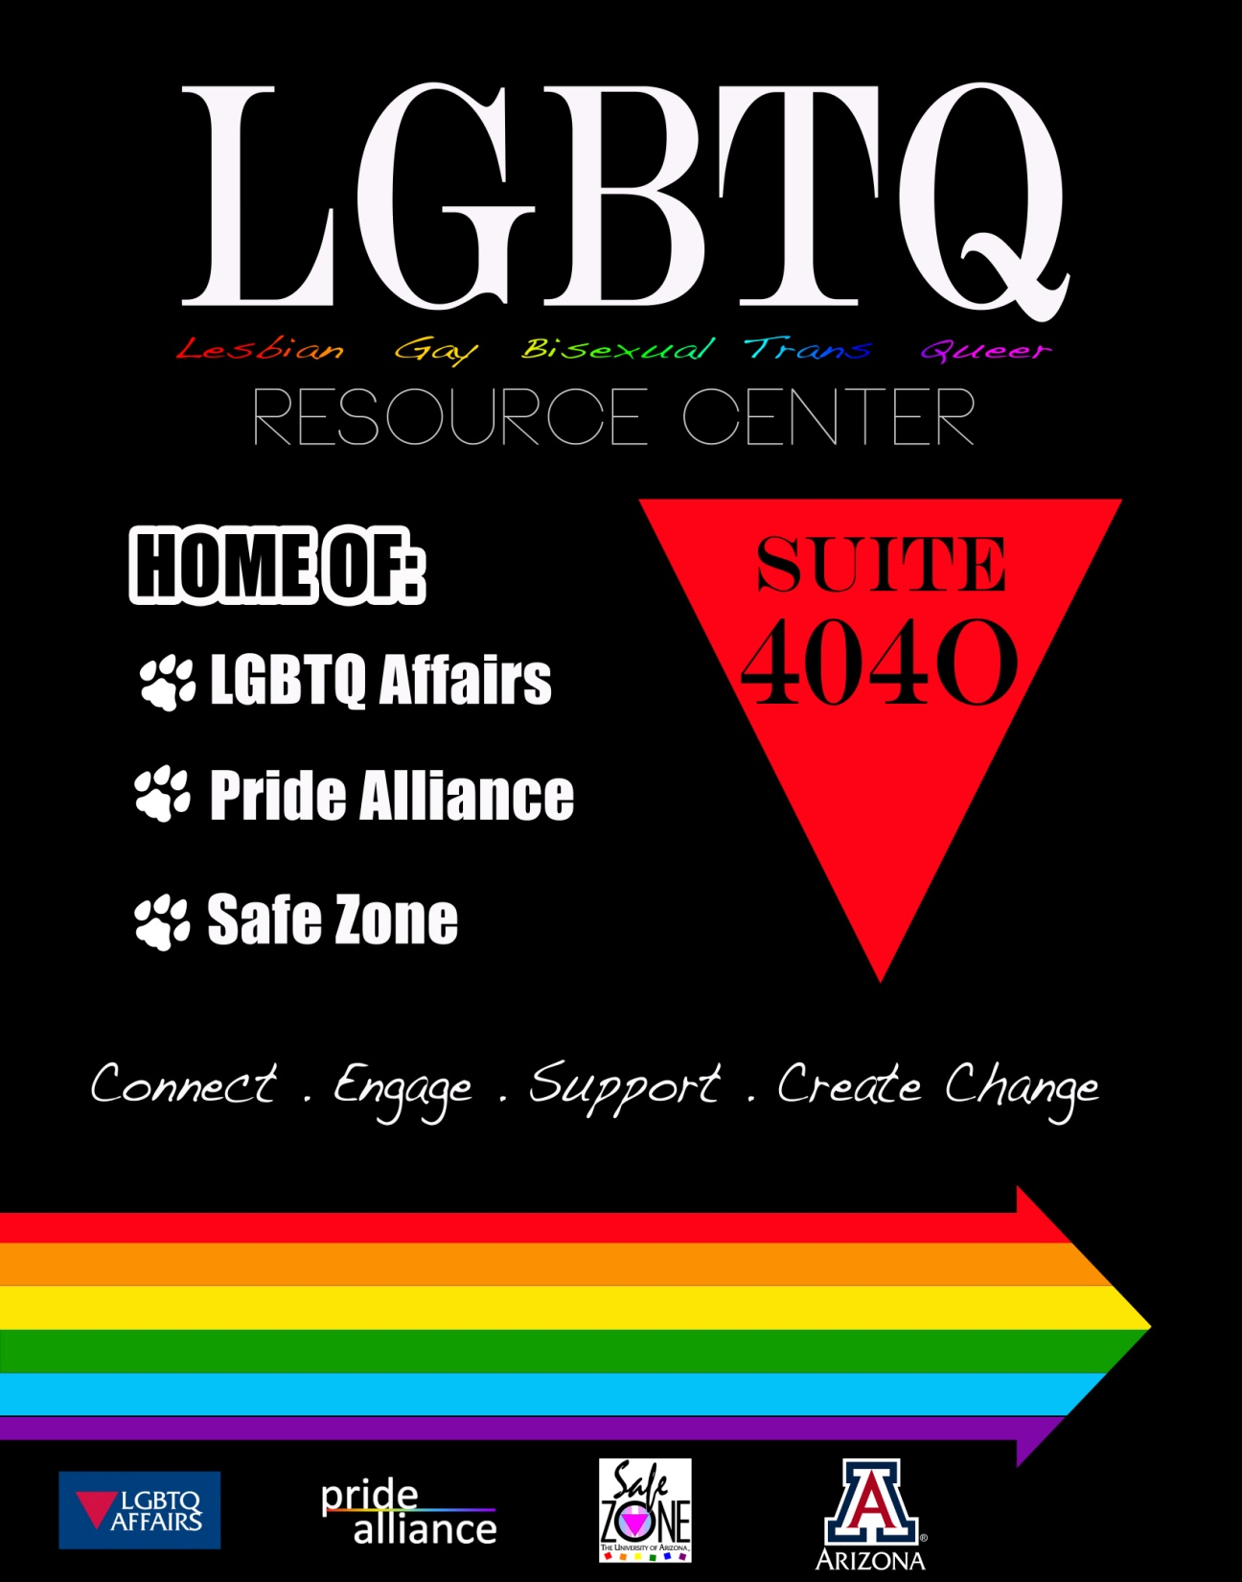
LGBTQ Resource Center
Notes:
Spring 2013 we moved into the LGBTQ Resource Center inside the Student Union—Room 404-O
Space Usage
Formerly Pride Alliance maintained a 15 x 20 ft. drop-in space inside the Center for Student Involvement and Leadership
During 2013-2014, 246 unique students visited the center a total of 2,124 times.
90% of Center participants are undergrads and 5% are grad students (N=1112)
The top 3 reasons participants use the LGBTQ Resource Center (N=1835):
Social/Safe space (40%)
study (20%),
eat lunch (16%)
It is their home away from home…
When asked what the LGBTQ Resource Center meant to them, students describe the impact:
“I wholeheartedly believe that if this center were not on campus, I would have already dropped out of college after my first semester at the University of Arizona. I don't think it has saved my life necessarily, but it has definitely saved my future.”
“The center has without a doubt helped keep me here at the University of Arizona when I was close to giving up and quitting. This space is VITAL to my well being and the involvement opportunities help solidify my connection to the queer community here on campus, which has had a direct effect on my grades and self confidence”
“The center is my second home. I am safe and accepted here.”

Slide 8
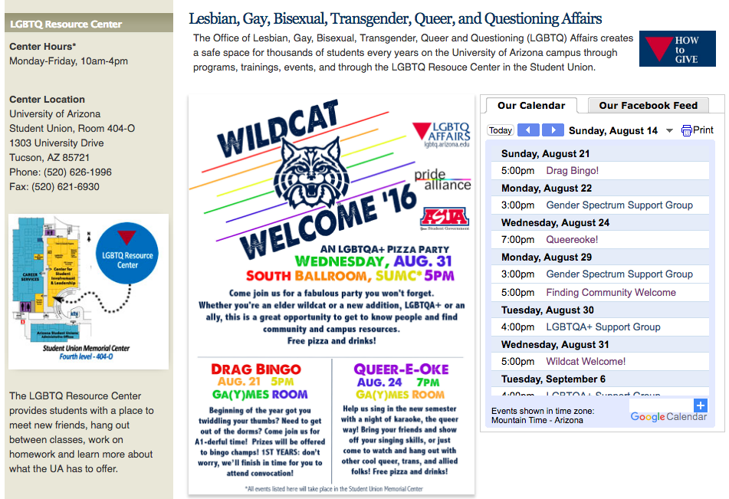

Slide 9
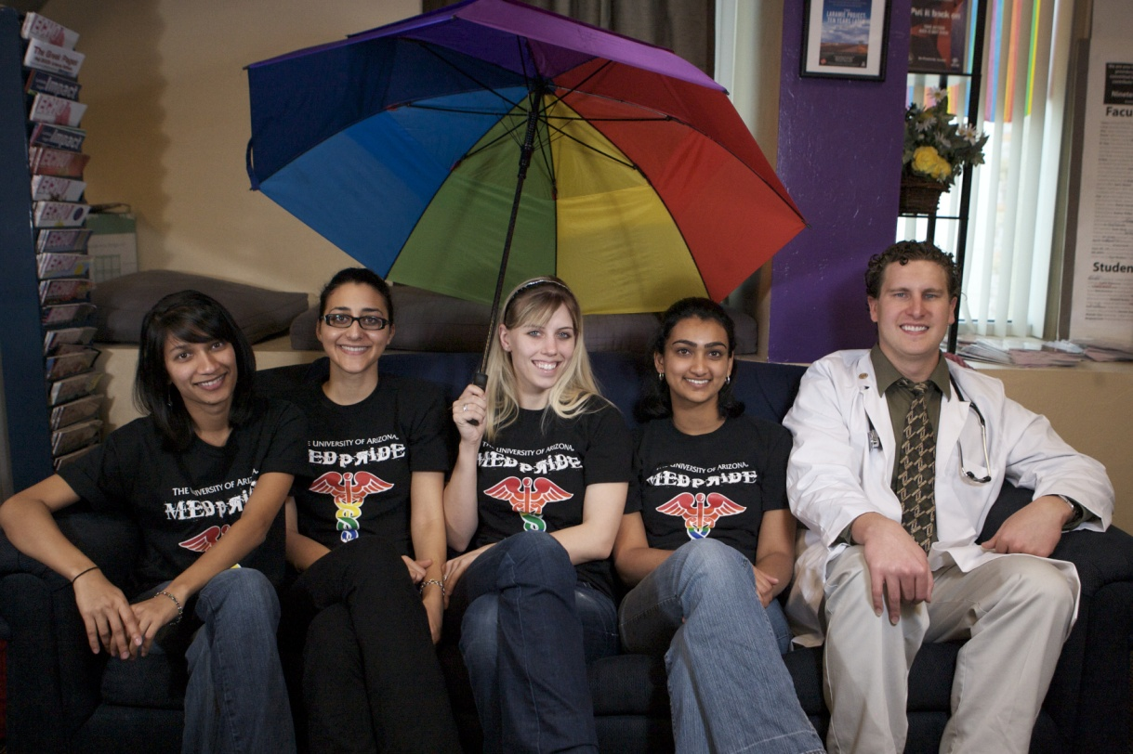
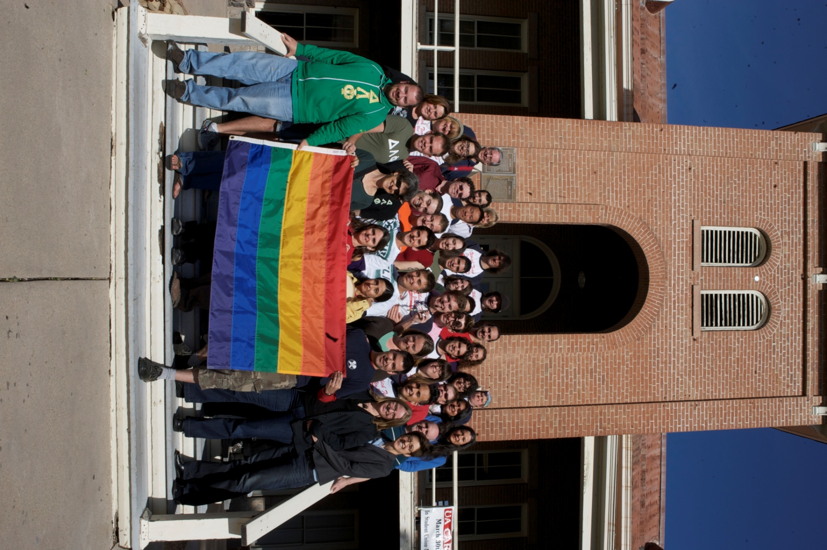
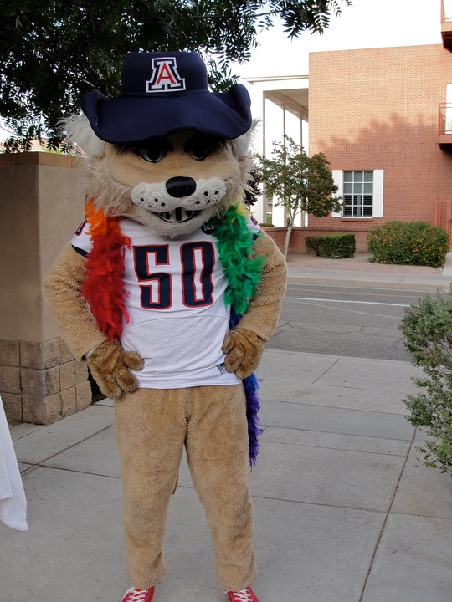
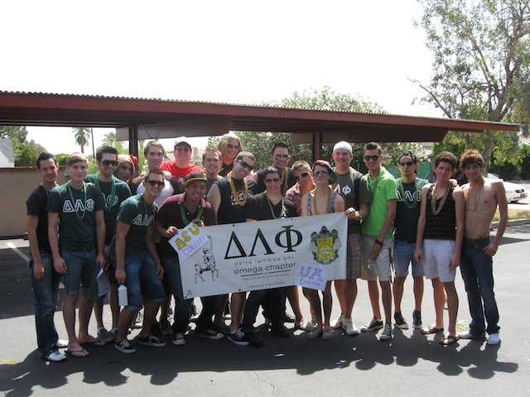
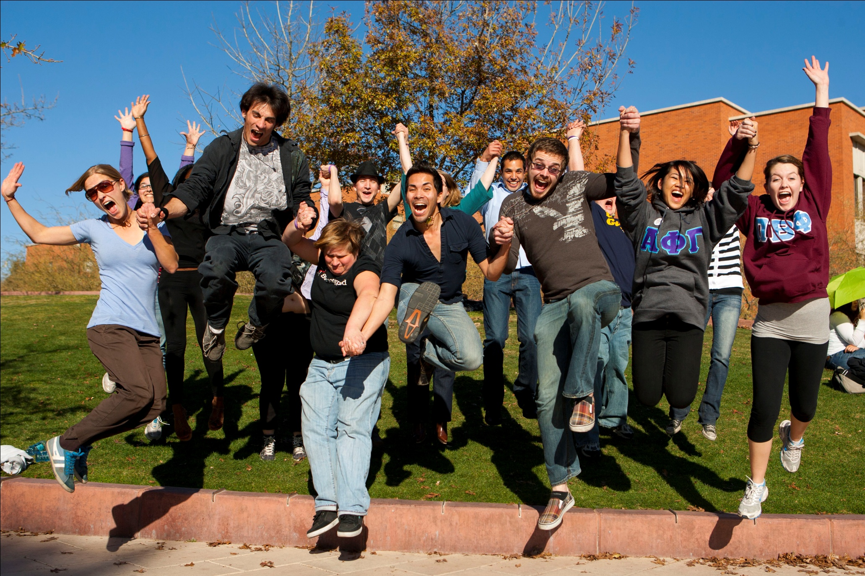
A hub for LGBTQ Work on Campus
Notes:
As the Program Director for LGBTQ Affairs, I serve as hub for LGBTQ work happening at UA, which equips the institution to better serve our LGBTQ students…and after all, serving students is why we are all here.
We support our 4 recognized LGBTQ student groups on campus—I directly advise Pride Alliance, our largest LGBTQ student org; I also work closely with DLP, MedPRIDE & Pride Law. And I work with a variety of other student organizations across campus.
We work with the Institute for LGBT Studies, Out Reach and serve on the President’s LGBTQ Advisory Board.
We are part of Tucson’s Queer Strategic Partnership—where we work closely with the leading LGBTQ community organizations like Wingspan, SAAF, PFLAG, TIHAN, Alliance Fund, Chamber of Commerce, City Commission, Tucson pride and others!
We have 3 major areas of focus: Providing support (Support Groups), Building a Healthy Community (Events/Intern Program), and Educating the Campus (Safe Zone and Panels)
A little bit about the programs we offer…

Slide 10
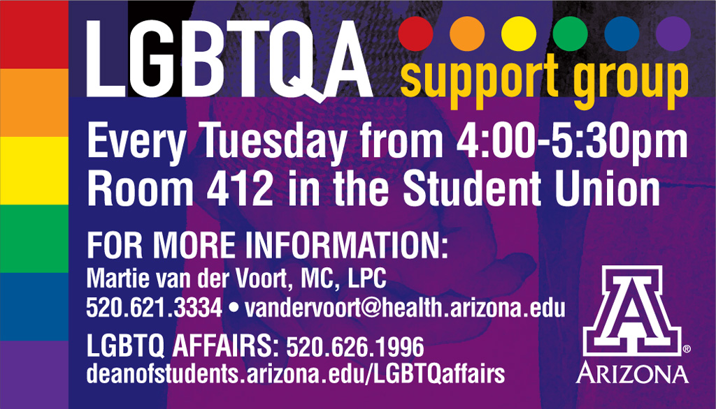
Notes:
Providing support
-I meet one on one with students
And we have 3 groups:
1. LGBTQ SUPPORT GROUP
This is a collaborative program with Counseling and Psychological Services through Campus Health. This group is a safe place for UA students, faculty and staff to talk in an open and supportive environment about issues impacting their lives and the LGBTQ and Allied community. Group topics originate from participants, examples include: coming out, family dynamics, relationships, gender-identity/transitioning, sexual assault, coping strategies for unsupportive families and friends, how to develop positive self-esteem, and media representations. During 2014-2015, 69 unique students participated in this group, with an average of 10.7 students attending group each week.
2. QPOC
The signage up there is old, they haven’t sent the new marketing. But it will be in AASA from 5-6pm in this upcoming Fall 2015. During 2014-2015, 25 students participated in this group.
3: Gender Spectrum Support Group

Slide 11
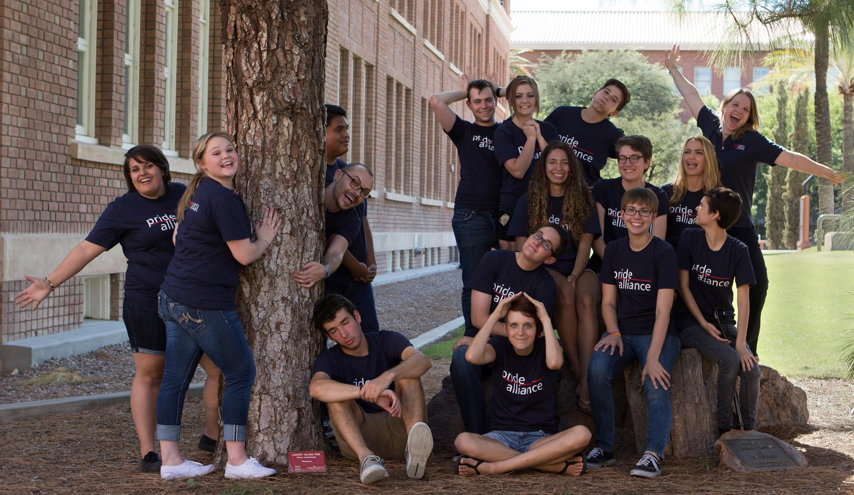
Pride Alliance Intern Team – Fall 2014
Notes:
Building a Healthy Community (Events/Intern Program),
PRIDE ALLIANCE Internship Program
We started an internship program with Pride Alliance in spring of 2010 with 6 student interns. At this point we have doubled in size to a team of 12 interns, graduate student volunteers and the Pride Alliance co-directors.
Interns are responsible for planning events, overseeing the resource center and conducting outreach.

Slide 12
Notes:
The interns take a lead on organizing all the events we put on. During the 2014-15 year the team put on 71 events, impacting 6,157 participants. Some highlights include:
Welcome Week Events
Coming Out Week
Transgender Awareness Week
Day of Silence
Second Chance Prom
Rainbow Graduation
Films, lectures and much more!

Slide 13
Next training:
Visit website for
most up to date information. Register online at UA LGBTQ Affairs website
(lgbtq.arizona.edu)
Campus-wide program committed to making UA a safer, more welcoming, and inclusive environment for LGBTQ people
The complete Safe Zone training consists of two sessions, including a General Education and an Ally Development workshop
Participants receive a Safe Zone placard to display indicating support and nurturance for LGBTQ students, staff, and faculty on our campus
We also provide speakers, panels, and lecturers upon request!
Notes:
Educating the Campus (Safe Zone and Panels)
SAFE ZONE TRAINING & ALLY DEVELOPMENT
Safe Zone is a campus-wide training program that prepares members of the campus to be effective allies to LGBTQ people. It is a 4.5 hours training split into two workshops.
Since 2010 over 5,500 participants have attended Safe Zone Workshops:
Workshop participants are comprised of 70% students and 30% staff/faculty.
*96% of participants agree that as a result of the Safe Zone training they feel a greater sense of commitment to serving as an ally to the LGBTQ community and are prepared to do so.
* I worked with an MPH graduate student in 2011 to conduct an assessment of the Impact of Safe Zone on the campus and we found that in terms of Campus Climate, 90% of LGBTQ respondents said that Safe Zone helps them feel better about the campus climate toward LGBTQ people—so we know that the visibility that Safe Zone brings about is having a positive impact on how safe LGBTQ students feel on campus. (200 survey respondents)
In fact, 73.58% of respondents agreed or strongly agreed that Safe Zone made them feel safer on campus (22.64% neither agree nor disagree)
*This program has been awarded a grant from the Alliance Fund for 5 years in a row, including the Leos-McCall award for exemplary grant proposals.
We also do presentations and panels in classes across campus. Last year we receieved 47 requests and fulfilled 41 of them, impacting 1,300 participants. Panel topics range from coming out, to transgender identities, to issues faced by LGBTQ adolescents.

Slide 14
Impact of Safe Zone Program
I have a Safe Zone placard on my wall, and in my position working and mentoring students I have had clear and open communication with LGBTQ students regarding their personal struggles and relationships. I think the placard was the key that let the students know they could open up to me about all of the challenges they were facing in their lives.
-UA Staff, from Impact of Safe Zone Survey, spring 2011
I consider the UA Safe Zone workshops to be the best, most directly applicable workshops I have ever attended on the UA campus. LGBTQ leadership is outstanding here at the U, and a source of great pride for me and many of my classmates.
-UA Student, from Impact of Safe Zone Survey, spring 2011

Slide 15
What are LGBTQ Students experiencing?
LGBTQ students face challenges both in k-12 educational settings and in colleges.
Personal challenges include facing verbal and/or physical harassment, financial problems, lack of peer or mentorship groups, and more.
Notes:
What do you need to be aware of in the classroom?
Let’s look at some research…

Slide 16
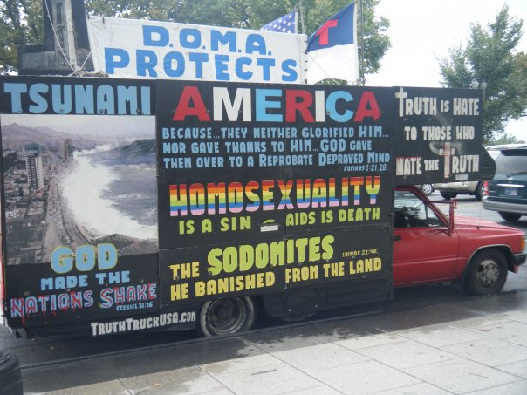
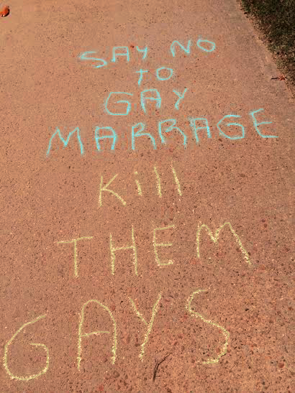
Hostile School Climates
GLSEN’s 2013 School Climate Survey found:
LGBT students felt unsafe because of their sexual orientation (55.5%) and their gender identity (37.8%)
Additionally, 74.1% of LGBT students reported being verbally harassed, and 36.2% reported being physically harassed (pushed or shoved)
16.5% reported being physically assaulted (injured) at school in the past year.
GLSEN has also released state-level data and found that 95% of Arizona respondents regularly heard “gay” used in a negative way, and only 16% were taught positive representations of LGBT people, history, and events.
Over the last decade and a half, more than one person a month on average has been reported to have been killed in the U.S. because of their perceived gender identity.
Gay, lesbian, and bisexual youth are 4 times more likely to attempt suicide. Transgender youth are 9 times more likely to attempt suicide.
Notes:
Student Experiences
84.6% of LGBTQ students reported being verbally harassed, 40.1% reported being physically harassed and 18.8% reported being physically assaulted at school in the past year because of their sexual orientation.
63.7% of LGBTQ students reported being verbally harassed, 27.2% reported being physically harassed and 12.5% reported being physically assaulted at school in the past year because of their gender expression.
Hostile School Climate
72.4% heard homophobic remarks, such as "faggot" or "dyke," frequently or often at school.
Hearing phrases like “no homo” and “that’s so gay” affect LGBTQ students
Acknowledge that WORDS HURT more than anything

Slide 17
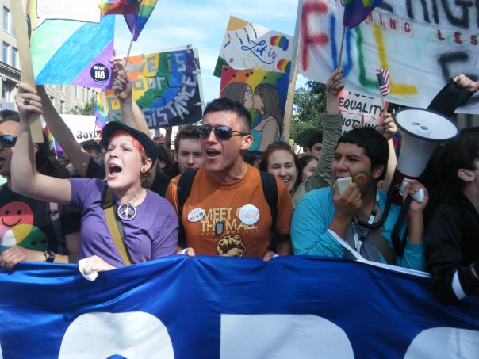
Chilly Climates in Higher Education Settings
Campus Pride’s 2010 State of Higher Education for Lesbian, Gay, Bisexual & Transgender People reveals a “chilly” campus climate for LGBTQ students staff and faculty nationwide:
One quarter (23%) of LGBQ staff, faculty, and students reported experiencing harassment.
More than half of all faculty, students, & staff hide their sexual identity (43%) or gender identity (63%) to avoid intimidation.
More than a third of all transgender students, faculty, & staff (43%) and 13% of LGBQ respondents feared for their physical safety.
Notes:
Campus Pride’s National College Climate Survey. The sample for the 2010 survey consisted of a total 5,148 participants (students, staff, faculty, and admin) from all 50 states and the District of Columbia.
About 77% of the sample was white, almost ½ of the sample was female, and 1/3rd of the sample identified as gay. The largest cohort responding were undergraduates at almost half of the sample.
Data collection was conducted through surveys.

Slide 18
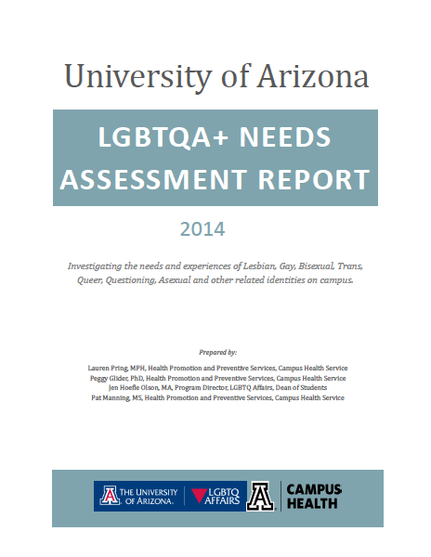
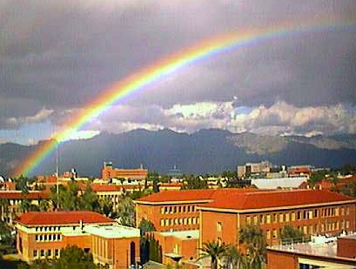
UA LGBTQ+ Needs Assessment Survey
One quarter (25%) of LGBTQ+ students seriously considered suicide, 3x more than their cisgender/heterosexual peers.
3x more trans students felt unsafe on campus than their
LGBQ+ peers. Of those, gender questioning students felt
the least safe with 0% saying they felt
“very safe” on campus.
LGBTQ Students are diagnosed with
anxiety/depression 2x more frequently
than their cisgender/heterosexual peers.
Notes:
You can find the full Needs Assessment on our website!

Slide 19
Positive Interventions:
Empathy, empathy, empathy
Teacher intervention
School policies
Shifting school climate (classroom discussions, visible support for LGBTQ people)
Notes:
So, we know this is happening in our schools—what can we do about it? And how can you support future teachers in dealing with this stuff?
Always empathize with your students and teachers

Slide 20
What Teachers can Do
Intervene when they hear bias-related comments and slurs. Use each comment as an opportunity to provide education and reaffirm school policy.
Request training on preventing harassment and discrimination
Set the climate in their classrooms early and as often as necessary
Treat all forms of bias-related harassment and slurs as serious and preventable
Find out about community resources and information
Integrate representations of LGBTQ people into existing curricula.
Notes:
Teacher Intervention is Essential around this stuff—Ignoring it won’t make it go away—teachers need to set the tone and intervene when they hear bias-related comments and slurs. Use each comment as an opportunity to provide education and reaffirm school policy.
Shift School Climate
Set the climate in their classrooms early and as often as necessary
Treat all forms of bias-related harassment and slurs as serious and preventable
Integrate representations of LGBTQ people into existing curricula.
The presence of supportive staff contributed to a range of positive indicators including fewer reports of missing school, fewer reports of feeling unsafe, greater academic achievement, higher educational aspirations and a greater sense of school belonging. (From GLSEN 2009 Survey)

Slide 21
What Schools Can Do
Establish and publicize a harassment policy that specifically includes sexual orientation and gender, including gender identity, appearance, and behavior
Train teachers and staff to intervene
Support the establishment of a Gay-Straight Alliance (GSA) or similar student club
Ensure that students know where to go for information and support
Introduce curriculum that includes LGBTQ people and information
Notes:
School Policies—encourage your students and teachers to know their school’s policies—we know that school policies matter for how students are treated
Students attending schools with an anti-bullying policy that included protections based on sexual orientation and/or gender identity/expression heard fewer homophobic remarks, experienced lower levels of victimization related to their sexual orientation, were more likely to report that staff intervened when hearing homophobic remarks and were more likely to report incidents of harassment and assault to school staff than students at schools with a general policy or no policy. (From GLSEN 2009 Survey)

Slide 22
We All have a Part to Play in Creating Safe Schools
Curriculum infusion is essential to get students talking and learning about LGBTQ identities. This helps them see LGBTQ people as human beings and not a minority groups that should be bullied
Family can not buffer discrimination entirely. Students need peer groups and environments that are supportive and nurturing. We can not assume that all families are accepting or safe.

Slide 23
As Hermann-Wilmarth and Ryan argue, “The focus of these conversations is the consideration that all children—not only those in LGBT (lesbian, gay, bisexual, transgender) families and those who may, now or later, identify as LGBT, but all children—leave school understanding that there are multiple ways to create family, to fall in love, and to express oneself in the world” (2013, p. 226).

Slide 24
Children With Same-sex Parents Are A Racially, Culturally, And Geographically Diverse Group
Households headed by same-sex couples are reported in virtually every U.S. county according to the U.S. Census.
In rural states, such as Wyoming and Alaska, and in southern states households headed by same-sex couples are more likely to have children than same-sex households in other states.
Hispanic and African-American same-sex couples are about twice as likely to be raising children as white non-Hispanic same-sex couples.
Notes:
Why bring queer readings of texts and queer texts into bilingual classrooms and classrooms with Latino students? Hispanic and African-American same-sex couples are about twice as likely to be raising children as white non-Hispanic same-sex couples. In other words, there are more queer families in Mexican American and African American households than in White households yet the available books for children’s feature White families and children. Additionally, conversations about queer issues have historically been left out of the conversations in bilingual teacher preparation.

Slide 25
Books about Diversity of Families
And Tango Makes Three
by Justin Richardson and Peter Parnell, illustrated by Henry Cole
Antonio’s Card/ La Tarjeta de Antonio
by Rigoberto González, illustrated by Cecilia Concepción Álvarez
ABC A Family Alphabet Book
by Bobbie Combs, illustrated by Brian & Desiree Rappa
Who’s in a Family
by Robert Skutch, illustrated by Laura Nienhaus
Who’s In My Family? All About Our Families
Robie H. Harris, illustrated by Nadine Bernard Westcott

Slide 26
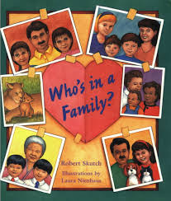
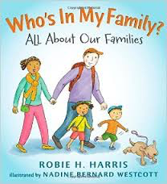
Notes:
First I’m going to quickly show you two examples of highly popular children’s books that depict queer characters (as Identity, or queer as a synonym for LGBT populations). The books on this page are books that most teachers in my course are familiar with and they are also books which can be found on banned books lists.

Slide 27
Two queer bilingual picture books

Slide 28
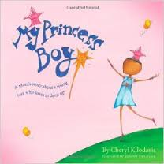
Additional Recommended Texts with Queer Protagonists
Marisol McDonald Doesn’t Match (2011)
My Princess Boy (2009)
The Boy Who Cried Fabulous (2004)
Morris Micklewhite and the Tangerine Dress (2014)
Notes:
with her.

Slide 29
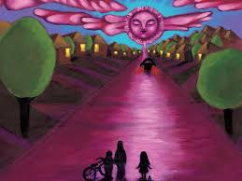
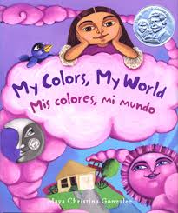
“Feeling an affinity for the hot pink sky helped give me a sense of self and belonging that I carried with me into adulthood and my coming out” (Gonzalez, 2015).
Notes:
The following slides are about the work of Maya Christina Gonzalez. Important to note that Call me Tree is the third book in her trilogy that connects children to nature. (My Colors My world, I know the River Loves Me). “I realized that not seeing any queer or Chicana representation in children’s books or any media for that matter, left me feeling invisible and irrelevant. But feeling an affinity for the hot pink sky helped give me a sense of self and belonging that I carried with me into adulthood and my coming out.”

Slide 30
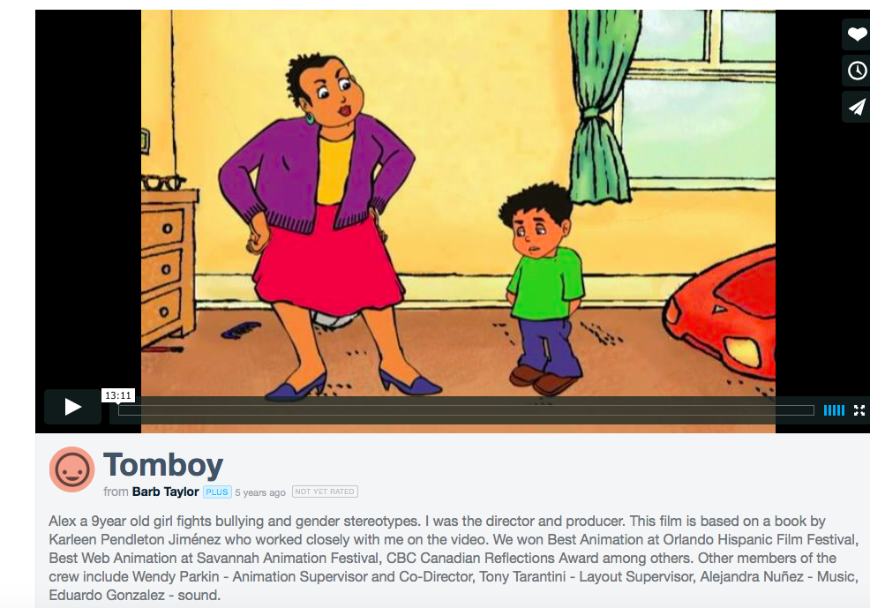

Slide 31
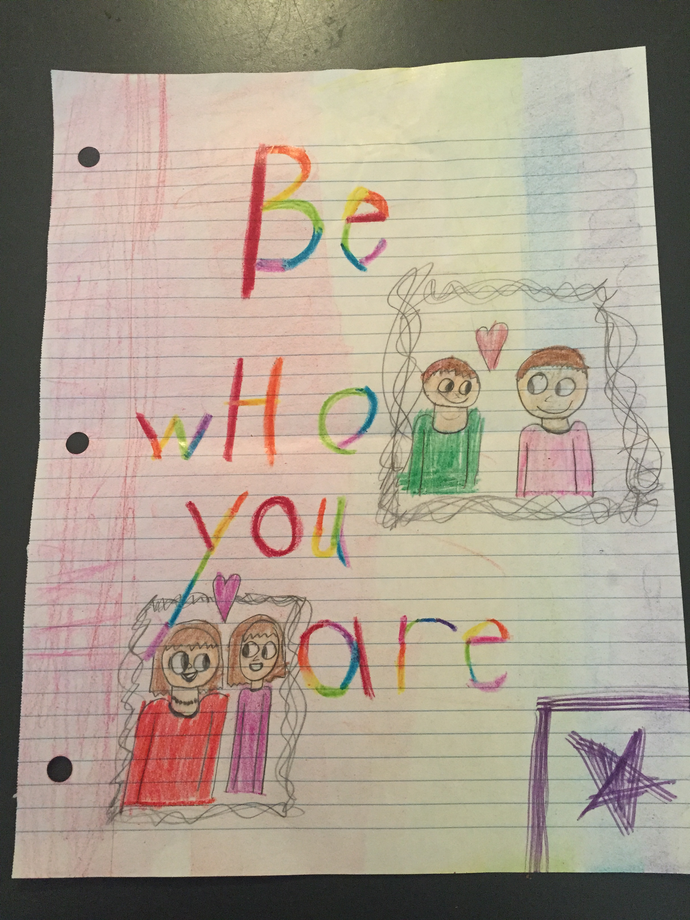

Slide 32
Scenarios:
What Will you Do?
Notes:
Each table is going to have one of 4 scenarios. And you will have 3 minutes to talk about what you would do in that situation…
Turn to page 3 of your handout and I will assign your table a scenario—we have 5

Slide 33
Scenario 1
A lesbian student teacher seeks your advice about what to say to her students who keep asking her if she has a boyfriend or a girlfriend. What do you say?
Notes:
Help them understand how a question that is completely innocuous for heterosexual student teachers can be a big deal for LGBTQ student teachers.
They could say:
I’m curious, why are you asking?
That’s not something I want to talk about.
Since that has to do with my personal life, and we’re not here to learn about me, that is not something I want to talk about.
Another issue to consider when supporting an LGBTQ student teacher: Does the school they are working in or eventually looking for a job in have an inclusive non-discrimination policy? Sexual orientation and gender identity and expression? (we currently have two trans men who are student teaching and this was important for them). This may be something important for future teachers when looking for a district they want to work in if they are LGBT
How do you respond to…“Are you gay?”
There are many reasons a student or an adult might ask this question and many different ways to respond. It might be curiosity — especially on the part of students — or it might be to get a rise out of a teacher. For children who have LGBT parents or family members it might be a way to open up a conversation with someone who they think understands their family. Students often have questions about an educator’s family life, such as “Are you married?” or “Do you have children?” A good initial response to the question, “Are you gay?” might be:
I’m curious, why are you asking?
Would you feel differently if I was?
An educator who is gay can decide if this is a moment that seems right to be open about his or her sexual orientation. If an educator is out to the principal, it is advisable to talk to the principal ahead of time about this possibility. It is easier for colleagues to support openly LGBT educators if they have the information ahead of time. LGBT educators who are not open about their sexual orientation or gender identity might say:
That’s not something I want to talk about.
Since that has to do with my personal life, and we’re not here to learn about me, that is not something I want to talk about.
Heterosexual educators also have different options to respond to this question. Instead of answering directly, they may also want to engage in dialogue by asking questions such as:
Would it make a difference to you if I was gay?
Why do you ask?
That’s not something I want to talk about.
Some heterosexual educators do not come out as heterosexual to support their LGBT colleagues.

Slide 34
Scenario 2
A student teacher comes to you to seek your advice, because they have a student in their class with same sex parents. What do you say?
Notes:
Help them understand that there will be same sex parents in the school, that is completely common and they need to respect all types of families to support the children…they should not treat them any differently than other families (except if their child is being harassed in school because of their family.
To teach them how to deal with Same sex parents…do not panic, treat them the same and be aware that there will be same sex parents in the school and they need to respect all types of families to support the children….it might help them be better teachers to understand what the home life is like for each student.

Slide 35
Scenario 3
A student teacher shares with you that many kids in his class use the phrase “that’s so gay” to describe everything from crayon colors to a math problem. He is uncomfortable with this and wants to say something, but is not sure how to address it. What do you say?
Notes:
All student teachers should provide a safe and positive environment in the classroom for all of their students.
How do you respond to the phrases: “That’s so Gay” or “No Homo”
Stop It:
Keep it simple with quick responses. You could say:
“Remember, we don‘t use put-downs in this class.”
It‘s not OK to say “That‘s so gay.”
“What did you mean by that?”
“You may not have meant to be hurtful, but when you use the word ‘gay’ to mean something is bad or stupid, it is hurtful.”
Educate:
If you have the time and opportunity to educate on the spot, do it. If you don‘t, make time later.
Be clear with students that when they use the word “gay” in a negative way they are being disrespectful. Also be clear that using the phrase “That’s so gay” is hurtful to other students who may have parents, siblings, aunts, uncles, neighbors, friends or other family members who are gay.
In lessons on respect, stereotypes or prejudice include information about discrimination against lesbian, gay, bisexual and transgender people.
Be Proactive:
Develop an environment of respect and caring for all students in your class and school.
Establish clear school wide and classroom policies against name-calling and hurtful teasing.
If you have been hearing the phrase “That‘s so gay” in your class or school, be explicit that rules against name-calling include that phrase and other anti-gay put-downs.
Don’t Ignore It:
Ignoring name-calling and hurtful teasing allows it to continue and possibly get worse. If other students do not see action, they get the message that there is nothing wrong with it.
Harassment does not go away on its own.
Don’t be Afraid of Making the Situation Worse:
Almost any response is better than ignoring the situation. You may not know exactly what to say, but you must stop the harassment.
Taking action reaffirms limits. Interrupting name-calling isn‘t always easy. With experience you will become more comfortable in handling it.
Don’t Excuse the Behavior:
Saying “Josh doesn‘t really know what it means,” or “Sarah was only joking,” excuses hurtful behavior.
Don’t try to Judge How Upset the Target Was:
We have no way of knowing how a student is really feeling. Often, targets are embarrassed and pretend that they were not offended or hurt. Saying “Michael didn‘t seem upset by Laura‘s remark” trivializes the target‘s feelings. It tells the harasser that it is OK to make hurtful comments. It teaches not only the child targeted but also anyone in hearing range that they will not be protected from harassment.
Don’t be Immobilized by Fear:
Making a mistake is far less serious than not acting at all. You can always go back to the student and say or do something else if you feel you did not respond well.

Slide 36
Scenario 4
Jorge, a boy in the class, occasionally comes to class wearing makeup, nail polish, and feminine blouses. Xe is often mocked by peers before/after class. You have never witnessed physical harassment and do not know how the student identifies. Would you talk to this student about their gender expression or identity? If so, what would that conversation look like?

Slide 37
Top 5 Ways to Support LGBTQ Students & The Office of LGBTQ Affairs

Slide 38
Top 5 Ways You Can Support LGBTQ Students
1. Educate Yourself
Know general terms & learn about LGBTQ issues in your field
Don’t rely on students to educate you, do the work yourself
Take advantage of Safe Zone Trainings
Break down your own biases & recognize your privileges
2. Be a Visible Source of Support
Include LGBTQ themed flyers, posters and publications in your office
Display your support (Safe Zone Sign)
3. Don’t Make Assumptions
Don’t assume a student is heterosexual
Remember that you only know someone’s sexual orientation or gender identity if they tell you what it is
Notes:
Key Terms: Heteronormativity
Homonormativity
Queer
Gender Expression
Gender Identity

Slide 39
Top 5 Ways You Can Support LGBTQ Students
4. Be Inclusive in Language & Practice
Use gender-neutral terms (i.e. partner or significant other rather than gender specific terms like girlfriend or boyfriend)
Respect pronouns
Use LGBTQ instead of "homosexual”
Don’t let tension around sexual orientation/gender identity continue to be unaddressed because you’re not sure what to do.
5. Speak Up
Talk to your students and your colleagues
Support other allies
Confront comments that are heterosexist or gender identity biased

Slide 40
How you can support our office
-Know you are serving LGBTQ students
-Become a Safe Zone
-Know our campus resources
-Refer students to our office
Notes:
Know that you are serving LGBTQ Students—we all are, they are all of our students & it takes a village
Become a Safe Zone--We train people (not spaces) to provide a network of support—Safe Zone allies are bridges who link people who need help to the resources they need—it allows us to extend the reach beyond the grasp of the LGBTQ Affairs Office. People exit the training with a skill set, prepared to be effective members of the network of support.
Know our Campus Resources—thank you for inviting me in to share with you what we do
Refer students to us—LGBTQ students do deal with a lot of stress. Not all, but many. One example that sticks out is a student that Renee referred to me. She was concerned about a student who is in the midst of Coming Out and with that student’s permission, she was able to connect me to her. I never would have been able to connect to that student otherwise…but that referral allowed me to meet with and support that student at a crucial time in her life. We depend on the network of support and referral because we are a small office…

Slide 42
Need more information? Interested in LGBTQ+ Research, Teaching?
Carol Brochin, Ph.D.
Department of Teaching, Learning, and Sociocultural Studies
cbrochin@email.arizona.edu

Slide 43
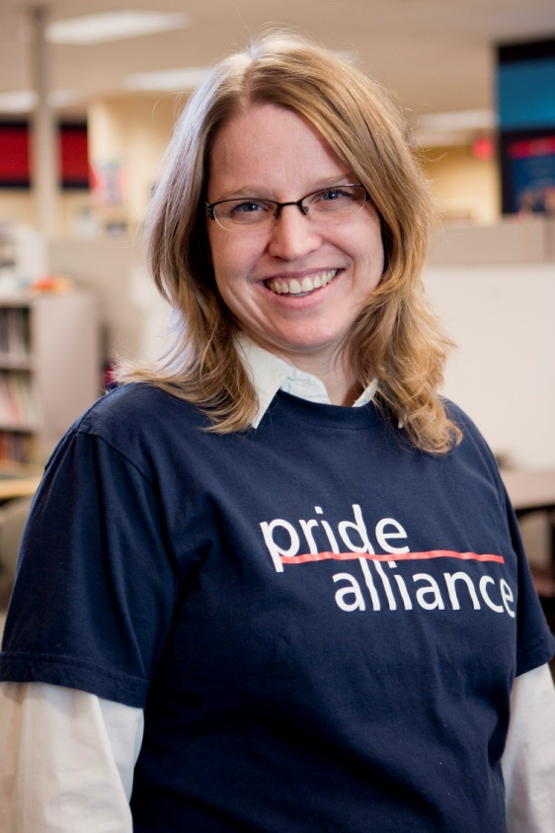
Need Advice? Need to Refer a Student? Jen Hoefle Olson, Program Director jhoefle@email.arizona.edu (520) 626-1996 Student Union, Rm 404-O

